Slide 1
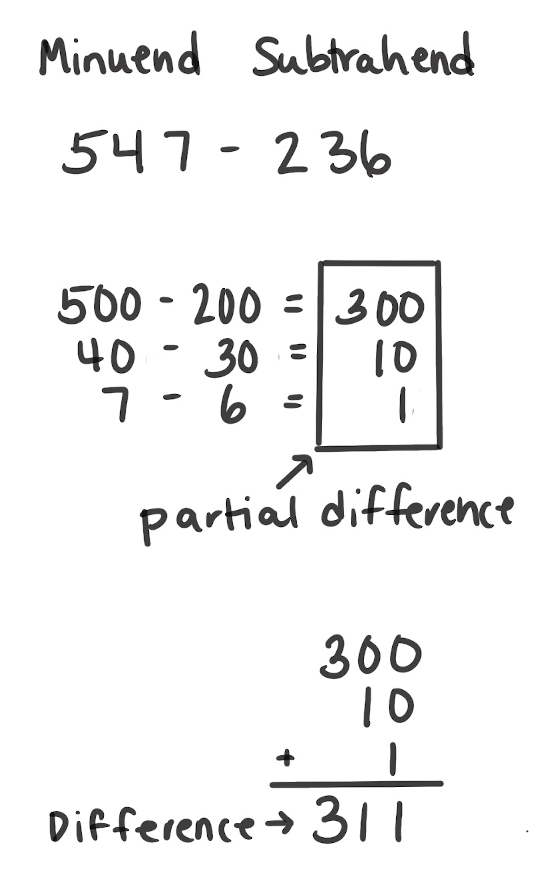
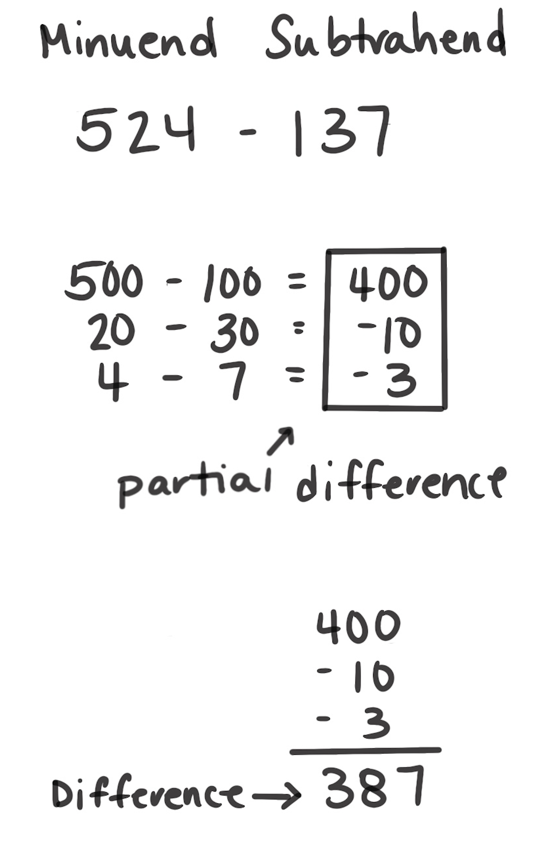
Partial Differences Strategy
How It Works: We can break apart addends in different ways. We can subtract the parts to find partial differences. Then, we can add the partial differences together to find the answer.
Choose how to break apart the numbers.
Subtract the parts to find each partial difference.
Add the partial differences.
The left example shows that 547 – 236 can be broken apart by place value. Subtract the hundreds, subtract the tens, then subtract the ones. Then, each of those partial differences is added to find the answer to the original problem.
The right example shows that the partial difference is a negative number. When you subtract the hundreds, 500 – 400 is 100. But when you subtract the tens and ones, it gives you negative numbers: 20 – 30 is – 10 and 4 – 7 is – 3. You will take those amounts away at the end. So, 10 and then 3 is then subtracted from 400.
When It’s Useful: This strategy is useful but sometimes not used because of the possibility that you’ll have to use negative numbers.

