Slide 1
More or Less Than 50
29 + 19 |  | 27 + 26 |  | 9 + 38

Slide 2
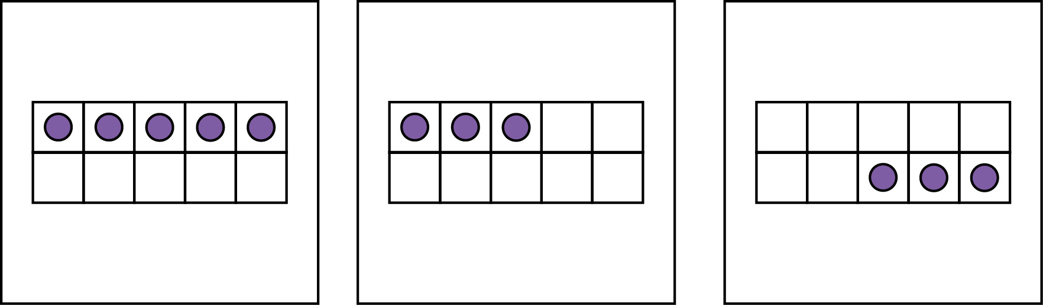
More or Less Than 10

Slide 3
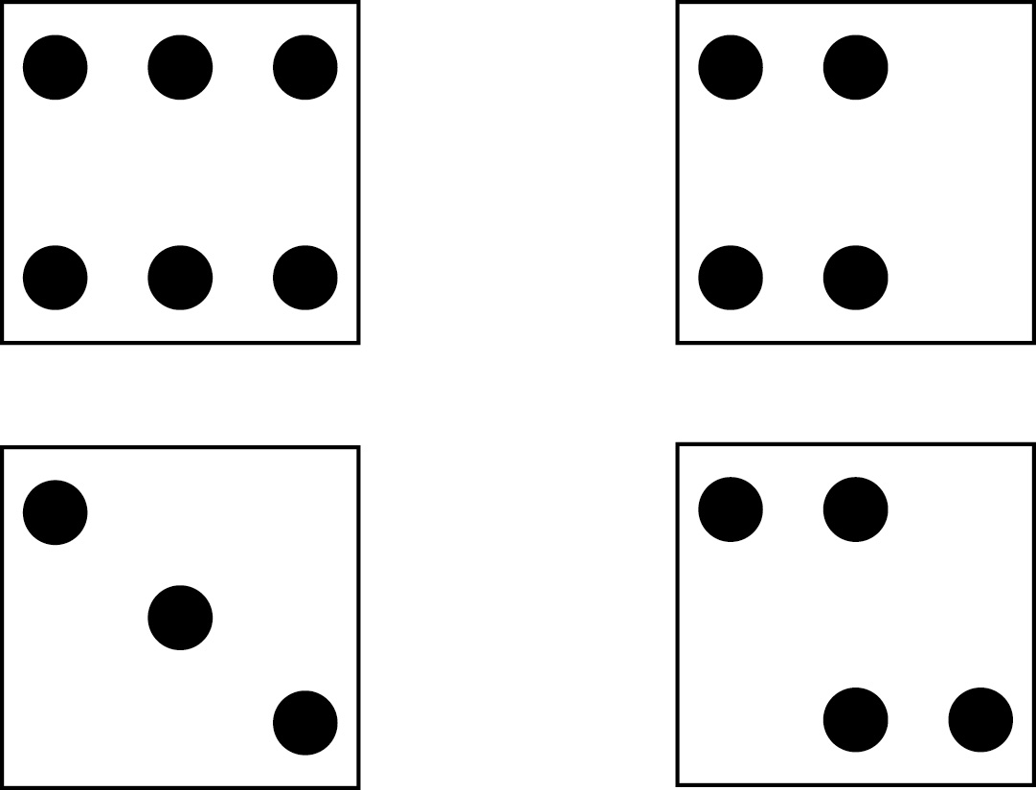
More or Less Than 20

Slide 4
More or Less Than 25
7 × 5 |  | 712 − 644 |  | 56 ÷ 2

Slide 5
More or Less Than 81
163 − 75 |  | 3 × 34 |  | 592 ÷ 6

Slide 6
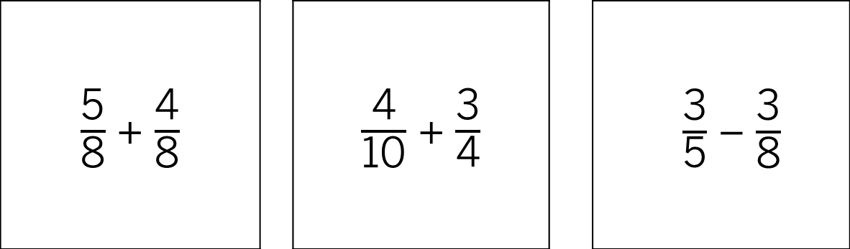
More or Less Than 1
$\frac{\text{5}}{\text{8}}$ + $\frac{\text{4}}{\text{8}}$ |  | $\frac{\text{4}}{\text{10}}$ + $\frac{\text{3}}{\text{4}}$ |  | $\frac{\text{3}}{\text{5}}$ − $\frac{\text{3}}{\text{8}}$
1

Slide 7
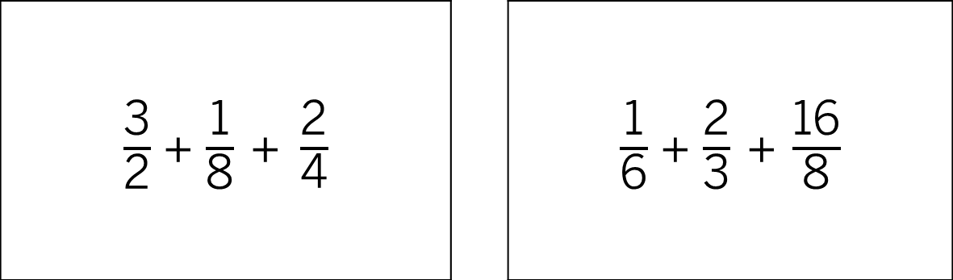
More or Less Than 3
$\frac{\text{3}}{\text{2}}$ + $\frac{\text{1}}{\text{8}} \text{+} \frac{\text{2}}{\text{4}}$ |  | $\frac{\text{1}}{\text{6}}$ + $\frac{\text{2}}{\text{3}} \text{+} \frac{\text{16}}{\text{8}}$

Slide 8
More or Less Than 25
? + 7 = 49 |  | 150 ÷ 4 = ? |  | 147 = 201 − ?

Slide 9
More or Less Than 8
1.7 + ? = 9.1 |  | 13.1 − 5.6 = ? |  | 8.4 ÷ 0.4 = ?

