Slide 1
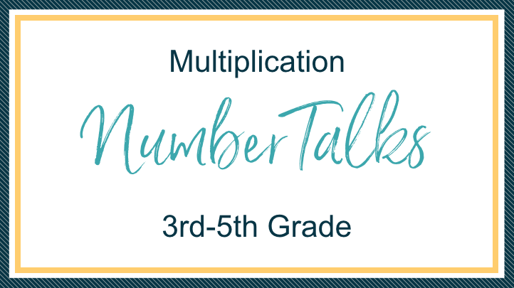
These Number Talk/Strings were purchased along with The Flexibility Formula course and are licensed to be used by the teacher who purchased it.

Slide 2

Meet Christina
Hi! I'm Christina
IT’S MY PASSION TO HELP TEACHERS AND CHILDREN LEARN TO LOVE MATH
Teaching math isn’t easy and for a lot of teachers, it isn’t fun…like AT ALL!! Especially in this era of education, there is a lot of unknowns about what and how we should be teaching. You are NOT alone.
With the implementation of new standards, assessments, and (for some) new curriculum, teachers are feeling bogged down and yet left out on their own to make sense of it all. I’m here to help with that.
I am a former middle school math teacher who learned, and taught, math the traditional way. That was until I realized that many of my students did not learn math the same way I did. So, I embarked on a journey to increase my understanding of mathematics in order to teach it to my students. Now I am a Recovering Traditionalist and a teacher educator who gets the pleasure of helping other teachers learn what I learned about how children think about mathematics.
I work with schools and districts to help teachers focus on the math content that is THE MOST IMPORTANT and how to weave that into instruction if it isn’t already in their curriculum (which most of the time it isn’t). These Number Talk/Strings were purchased along with the full Flexibility Formula 3-5 course and are licensed to be used by the teacher who purchased it.
www.BuildMathMinds.com

Slide 3
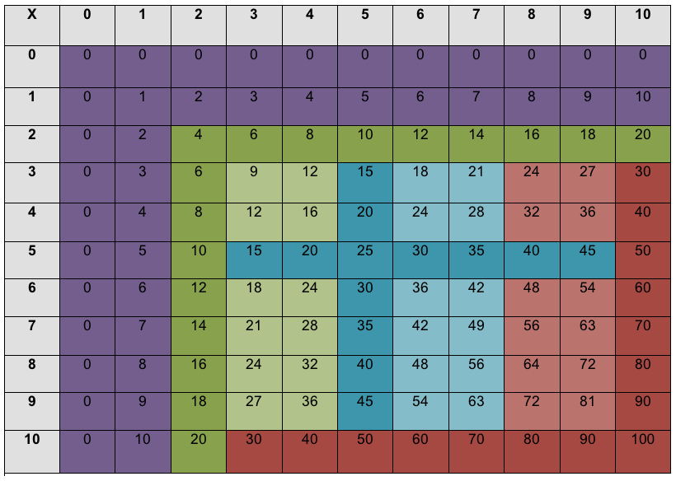
Multiplication Fact Chart - 4 Types of Facts
Notes:
Instead of teaching facts in isolation, these Number Strings are built on helping kids develop the 4 types of facts highlighted with the darker colors (green- x2, red - x10, blue - x5, and purple - multiplication properties of x0 & x1). Then once kids are solid with those we can build connections to those for the other facts highlighted with the lighter color (for example, light green of x3 & x4 connects to x2). Kids may see other connections (like I have x8 connected to x10, but some kids might do better connecting it to x2 and x4 by doubling and doubling again to get x8). The point is to be helping kids see and USE relationships instead of just memorizing their facts in isolation.

Slide 4
About These Slides
I don’t do ALL the types of number talks/string that you could do for a type of fact. For example, there are times I do a number string that shows commutative property for one type of fact but I don’t use it in other facts. But in that other fact I might do number string that start to lay the foundation for division. If you see a number string under one type of fact and it isn’t under another, then just copy the slides, paste them under the other fact you want them in and adjust the numbers.
Use these as a guide. You need to do what’s right for you & your students. DO NOT start with the first slide and work your way through. If your students don’t need a particular slide, skip it. If your students need more time on the idea we are trying to develop on a slide, then copy the slide and change the image or text to give them more opportunities to develop their understanding.
The order of developing the facts are x2, x10, x5, x1 & x0, x3, x4, x6 & x7, x9, and x8. This is based off the relationships I’m trying to help kids build. If you want to switch that up, go ahead. BUT, always be thinking about what relationship you want to help kids build.
www.BuildMathMinds.com

Slide 5
About These Slides
Modify the visuals. Sometimes I use a ten frame, sometimes I use dot patterns with a 5 emphasis, sometimes I use a number line, etc. I do this to give you examples of what you COULD do, not what you HAVE to do. If I use a number line and you think a ten frame visual would be better, then by all means use a ten frame.
One visual I do not use much in these Number Strings is the array/area model. You definitely can. It is a very powerful model that kids need exposed to. I chose not to use it as much in these as I view these slides as an introduction to multiplication. When kids are first learning with the array/area model they count each square (or item in the array) one-by-one. I wanted to give them visuals that help them see groups and that’s a bit harder for kids to see in the array/area model. The arrays & area models I do use, I colored to emphasize the 5 within the model.
www.BuildMathMinds.com

Slide 6
Notes:
These two slides were visuals I used to create the Number Strings. As you modify this document to fit the needs of your students you can use these slides as a way to copy & paste images that you want to use.

Slide 7
Notes:
This shows an example visual for the area model (top) and an array (bottom).

Slide 8

Building understanding of x2
Notes:
Helping them connect to addition doubles facts by seeing it as “2 groups of__.” The big idea is to help them see x2 is the same as doubling. Kids will most likely “see” each of the visuals add an addition problem, like 3+3, but through your questioning you want to help them see it as “groups of.” So the goal is to get them to see the images as “2 groups of ____”

Slide 9
Notes:
Start with things that are “easy.” the goal is to start to introduce how the only difference between addition & multiplication is that with both you are “joining sets” but with multiplication the sets have the same amount. So 3+2 can’t be thought of as multiplication because you don’t have the same amount in each group. But when you have 3+3 it can be thought of as 2 groups of 3, which mathematicians write as 2x3.

Slide 11
5
5
0
7
7
0
Notes:
Showing it on a number line. Kids are probably familiar with adding on the number line, so when using this visual be tying it to “2 groups of ____”

Slide 12
6
6
0
9
9
0
Notes:
Showing it on a number line. Kids are probably familiar with adding on the number line, so when using this visual be tying it to “2 groups of ____”

Slide 13
Notes:
Showing “2 groups of” in a ten frame

Slide 14
Notes:
Showing it with both groups on the top row

Slide 15
Notes:
Show using array model, connect to rekenrek if kids have used rekenreks. The color changes at 5 ‘beads’

Slide 16
Notes:
Show using array model, connect to rekenrek if kids have used rekenreks. The color changes at 5 ‘beads’

Slide 17
2 groups of 6 =
2 groups of 10 =
2 groups of 8 =
2 groups of 4 =
Notes:
Move to visualizing “groups of”

Slide 18
2 groups of 3 =
2 groups of 9 =
2 groups of 7 =
2 groups of 5 =

Slide 19
= 2 groups of 3 =
= 2 groups of 4 =
Notes:
Move to covering parts of the visual. Tell the kids the “whole” but ask what’s hiding. Leave one of the amounts in the group exposed so they have a visual to draw off of. Then move to where all the amounts in the group are covered. They can see how many groups, and you tell them how many total. They have to determine how many are in each group. This is where we start laying the foundation for a visual of division.

Slide 20
= 2 groups of __ = 10
= 2 groups of __ = 14

Slide 21
2 x 6 =
2 x 10 =
2 x 8 =
2 x 4 =
Notes:
Move to just the expressions

Slide 22
2 x 3 =
2 x 9 =
2 x 7 =
2 x 5 =

Slide 23
Building understanding of x10
Notes:
Helping them see it as more than just “add a zero.” We have groups of 10 or 10 groups of...and when we do, it makes the amount we are working with 10 times larger….it moves the amount over in the place value chart. 7 ones becomes 7 tens, 4 ones becomes 4 tens, then as they progress up 76x1 (76 ones) compared to 76x10 (76 tens) still has the same pattern.

Slide 24
Notes:
Start with things that are “easy.” Many students are good with counting by tens. So I’m putting 10 in each group. You can choose to change out what visual you prefer for “10” but the idea is to have them see visuals of 10 that they are familiar with but to now relate that “____groups of 10.” This visual will connect with expressions that have the 10 as the number of members, for example 2x10, 3x10, etc.

Slide 26
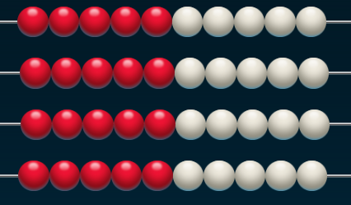
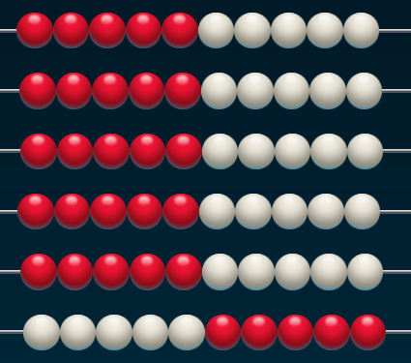
Images created using the Number Rack App: https://www.mathlearningcenter.org/web-apps/number-rack/
Notes:
Showing “___groups of 10” on rekenrek

Slide 27
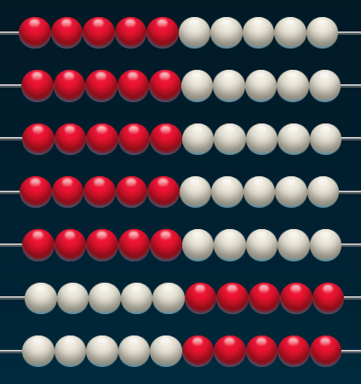
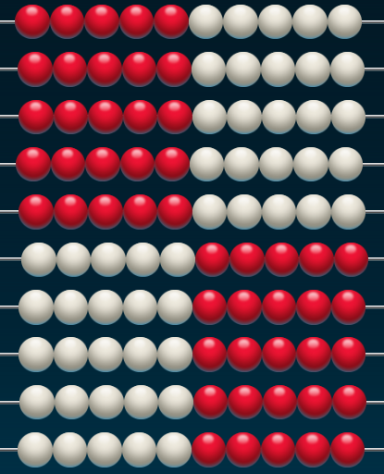
Images created using the Number Rack App: https://www.mathlearningcenter.org/web-apps/number-rack/

Slide 28
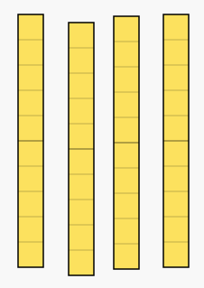
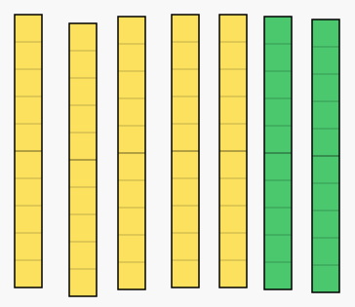
Images created using the Number Pieces App: https://www.mathlearningcenter.org/web-apps/number-pieces/
Notes:
Showing Groups of 10 using Base 10 Blocks

Slide 29
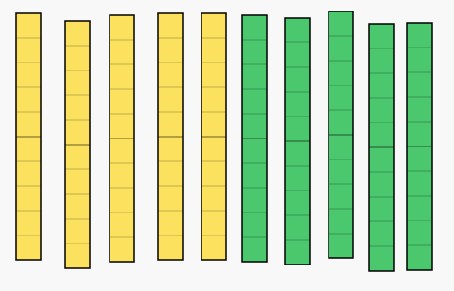
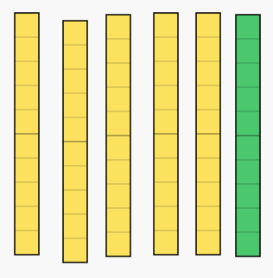
Images created using the Number Pieces App: https://www.mathlearningcenter.org/web-apps/number-pieces/

Slide 30
Notes:
Many kids will get comfortable with 10 as the amount of members in each group, but what about when we have 10 as the number of groups??? So these visuals are a way to help kids have a visual of “10 groups of____”

Slide 32
3
Notes:
Are they the same???? We start moving into laying the foundation of the commutative property by helping kids see that it doesn’t matter if the 10 is the members or the groups...we still get the same total.

Slide 33
5

Slide 34
7 groups of 10 =
4 groups of 10 =
5 groups of 10 =
8 groups of 10 =
Notes:
Visualization of “groups of”

Slide 35
10 groups of 2 =
10 groups of 3 =
10 groups of 10 =
10 groups of 4 =

Slide 36
10 groups of 2 =
2 groups of 10 =
10 groups of 5 =
5 groups of 10 =
Notes:
Connecting the “groups of” to the commutative property

Slide 37
10 groups of 6 =
6 groups of 10 =
10 groups of 8 =
8 groups of 10 =

Slide 38
10 x 6 =
6 x 10 =
10 x 8 =
8 x 10 =
Notes:
Move to just the expressions, but focus on the patterns and understanding not just that they are “adding a zero”

Slide 39
2 x 10 =
5 x 10 =
3 x 10 =
4 x 10 =

Slide 40
12 x 10 =
15 x 10 =
21 x 10 =
34 x 10 =
Notes:
Extend to larger quantities...don’t have to do if your students aren’t ready for it

Slide 41
Building a Strategy for x5
Notes:
Goal is to introduce the visual representation of x10 and how it relates to x5….if they don’t know x10 go to that section first, then we can use that to help kids with x5. Well, they can learn x5 without that relationship but they will be reliant upon skip counting. Relating x5 to x10 becomes a strategy that will last them long term as they move into multi-digit multiplication.

Slide 42
Notes:
Goal is to connect 10 groups to 5 groups….what has changed?

Slide 46
What is half of 8?
What is half of 80?
Half of 6?
Half of 60?
Half of 4?
Half of 40?
Notes:
These strings are designed to work on helping kids understand how to find “half of ____.” If they can’t do “half of” an amount quickly then doing this x5 strategy is difficult.

Slide 47
What is half of 3?
What is half of 30?
Half of 7?
Half of 70?
Half of 9?
Half of 90?
Notes:
These strings are a bit more difficult for kids to find ‘half of’. Many kids might say that you can’t take “half of 3.” The next slides are meant to help develop the idea of how to split the decade numbers that aren’t as friendly.

Slide 48
Draw a line on the picture to split the image in half
Notes:
If students don’t know what “half of” means then do these slides first before continuing. If they know “half of” then skip these.
Print these out and cover so only one picture is shown at a time (if working with small group) or project on a whiteboard for whole group. Draw (or imagine) a line going through the image that splits it in half…..How many are on each side of the line? What do you notice about each set of dots on either side of your line? What do you think it means to split an amount in half?

Slide 49
Draw a line on the picture to split the image in half
Notes:
Print these out and cover so only one picture is shown at a time (if working with small group) or project on a whiteboard for whole group. Draw (or imagine) a line going through the image that splits it in half…..How many are on each side of the line? What do you notice about each set of dots on either side of your line? What do you think it means to split an amount in half?

Slide 50
What is half of 20?
Half of 4?
Half of 24?
What is half of 20?
Half of 2?
Half of 22?
Half of 28?
Half of 26?

Slide 51
What is half of 60?
Half of 6?
Half of 66?
What is half of 60?
Half of 4?
Half of 64?
Half of 68?
Half of 62?

Slide 52
What is half of 40?
Half of 6?
Half of 46?
What is half of 40?
Half of 8?
Half of 48?
Half of 44?
Half of 42?

Slide 53
What is half of 10?
Half of 60?
Half of 70?
What is half of 10?
Half of 40?
Half of 50?
Half of 30?
Half of 90?

Slide 54
What is half of 10?
Half of 80?
Half of 90?
Half of 70?
Half of 50?
Half of 30?

Slide 55
10 groups of 6 =
5 groups of 6 =
10 groups of 8 =
5 groups of 8 =
Notes:
Connecting 10 groups of ______ to 5 groups of _____ without the visuals. Along the way reinforcing the prior lessons about how to easily take “half of” to get the answer.

Slide 56
10 groups of 4 =
5 groups of 4 =
10 groups of 7 =
5 groups of 7 =

Slide 57
10 groups of 3 =
5 groups of 3 =
10 groups of 5 =
5 groups of 5 =

Slide 58
10 groups of 10 =
5 groups of 10 =
10 groups of 9 =
5 groups of 9 =

Slide 59
10 x 4 =
5 x 4 =
10 x 6 =
5 x 6 =
10 x 7 =
5 x 7 =
10 x 3 =
5 x 3 =
Notes:
Just the abstract numbers and also gave a few without the “helper problem” of x10 before the x5. This is to see if they can use that strategy without being prompted to see the x10 first. Also moved to using the strategy with multi-digit numbers to help them see the real power of the strategy...it goes beyond just their facts.

Slide 60
5 x 6
5 x 7
Notes:
Can they do it without the helper problem??

Slide 61
10 x 14 =
5 x 14 =
10 x 16 =
5 x 16 =
Notes:
**Don’t need to do these if working with 3rd grade

Slide 62
10 x 12 =
5 x 12 =
10 x 24 =
5 x 24 =
Notes:
**Don’t need to do these if working with 3rd grade

Slide 63
5 x 6
5 x 3
5 x 7
Notes:
Can they do it without the helper problem??

Slide 64
5 x 8
5 x 4
5 x 7
Notes:
Can they do it without the helper problem??

Slide 65
5 x 12
5 x 14
5 x 17
Notes:
Can they extend to multi-digit? **Don’t need to do these if working with 3rd grade

Slide 66
Building understanding of x1 & x0
Notes:
These are properties of multiplication that are often taught as just rules to memorize (Any number times 1 is itself), but my 4 year old has learned that from his older siblings and has no clue what it actually means. We are wanting to help students develop these ideas so that the “rule” makes sense to them and they can apply it beyond just the facts. The goal is to help them answer the questions “What does it mean to multiply by 1 (or 0)?” “Why does the pattern you are noticing always appear?”

Slide 67
Notes:
Start with visual of “2 groups of ____” and then move to “1 group of___”. Kids will want to just say “It’s 3!” when shown “1 group of 3” but want them to start verbalizing what they are seeing as “groups of”. So when you show the “2 groups of ___” make sure to discuss it as “2 groups of ___” and not just the total amount.

Slide 69
Notes:
Move into showing “____groups of 1”...facilitate discussion of these as “groups of” instead of kids just wanting to tell the total amount of dots shown.

Slide 70
Notes:
Kids are familiar with ten frames and are used to just saying how many total dots they see...but use this familiar visual to change how we verbalize the amount. 7 dots can also be seen as “7 groups of 1”

Slide 71
Equal or Not?
Notes:
Connect the two visuals of “1 group of___” to “____groups of 1” to help build commutative property...Show the two visuals and ask if they are Equal or Not (some are not equal). When facilitating this string, remember to put an emphasis on “groups of” so the first image I would be leading them (if they don’t say it) to talk about it as “3 groups of 1” and “1 group of 3”.... “So, is 3 groups of 1 the same as 1 group of 3??”

Slide 72
Equal or Not?

Slide 73
Equal or Not?

Slide 74
1 group of 6 =
6 groups of 1 =
1 group of 4 =
4 groups of 1 =
Notes:
Move to visualizing “groups of”

Slide 75
1 group of 3 =
3 groups of 1 =
1 group of 5 =
5 groups of 1 =

Slide 76
1 x 4 =
4 x 1 =
1 x 9 =
9 x 1 =
Notes:
Move to just the expressions

Slide 77
1 x 3 =
1 x 6 =
1 x 10 =
1 x 7 =

Slide 78
1 x 4 =
1 x 12 =
27 x 1 =
1 x 732 =
Notes:
Extension to generalize the identity property: “Anything x1 is itself”

Slide 79
Notes:
Start with visual of “2 groups of ____” and then move to “1 group of___”, then to “0 groups of ___”. Basically you are hoping they say “There isn’t anything there!” when you advance to show the “0 groups of”....because there isn’t. (see next slide for how I would notate it)

Slide 80
2 groups of 3 = 6
1 group of 3 = 3
0 groups of 3 = 0
Notes:
How I would notate previous slide during the Number Talk

Slide 84
Notes:
Move into showing “____groups of 0”

Slide 86
0 groups of 6 =
6 groups of 0 =
0 groups of 4 =
4 groups of 0 =
Notes:
Move to visualizing “groups of”

Slide 87
0 groups of 3 =
3 groups of 0 =
0 groups of 5 =
5 groups of 0 =

Slide 88
0 x 4 =
4 x 0 =
0 x 9 =
9 x 0 =
Notes:
Move to just the expressions

Slide 89
0 x 3 =
0 x 6 =
0 x 10 =
0 x 7 =

Slide 90
0 x 4 =
0 x 12 =
0 x 27 =
0 x 732 =
Notes:
Extension to generalize the zero property: “Anything x0 is zero”

Slide 91
Building a Strategy for x3
Notes:
Goal is to connect it to x2, you double the amount and then it’s just one more group

Slide 92
Notes:
Start with visualizing “2 groups of___” and then add one more group

Slide 94
4 + 4 =
4 + 4 + 4 =
6 + 6 =
6 + 6 + 6 =
Notes:
Showing it as repeated addition...hopefully kids will visualize the groups from previous slides. If not, you can replace these slides with more visual pictures and just attach the number sentences to them through the discussion.

Slide 95
5 + 5 =
5 + 5 + 5 =
7 + 7 =
7 + 7 + 7 =

Slide 96
Notes:
Show ____groups of 2 then move into showing “____groups of 3”. This just shows another way to visualize it. Some kids might find it easier to think about it this way, but some kids might not.

Slide 97
Notes:
You can use this visual to help kids start to think about commutative property. This slide is not required, but wanted to show an example.

Slide 98
3 groups of 5 =
5 groups of 3 =
3 groups of 10 =
10 groups of 3 =
Notes:
Another way to discuss commutative property...tie it to the visual from previous slide

Slide 99
3 groups of 2 =
2 groups of 3 =
3 groups of 1 =
1 group of 3 =

Slide 100
3 groups of 3 = ____
3 groups of 6 = ____
Notes:
Move to covering parts of the visual. Tell the kids the “whole” but ask what’s hiding. Leave at least one of the amounts in the group exposed so they have a visual to draw off of. Then move to where all the amounts in the group are covered. They can see how many groups, and you tell them how many total. They have to determine how many are in each group. This is where we start laying the foundation for a visual of division.

Slide 101
3 groups of 4 = ___
3 groups of 7 = ___

Slide 102
3 groups of ___ = 15
3 groups of ___ = 9

Slide 103
2 groups of 4 =
3 groups of 4 =
2 groups of 7 =
3 groups of 7 =
Notes:
Moving to more abstract, but tie in the visual of “groups of” through the words

Slide 104
2 groups of 6 =
3 groups of 6 =
2 groups of 8 =
3 groups of 8 =

Slide 105
2 x 5 =
3 x 5 =
2 x 3 =
3 x 3 =
Notes:
Just the expressions, and move into ones with just x3 to see if they can do it without the helper problem of x2

Slide 106
2 x 4 =
3 x 4 =
2 x 9 =
3 x 9 =

Slide 107
3 x 8 =
3 x 6 =

Slide 108
3 x 5 =
3 x 7 =

Slide 109
3 x 10 =
3 x 4 =

Slide 110
Building a Strategy for x4
Notes:
Goal is to build the doubling strategy. x4 can be seen as x2, just doubled. You can extend it to get x8, you just double x4

Slide 111
Notes:
Goal is to connect 2 groups to 4 groups...what changed?

Slide 114
What is 3 + 3?
What is 3 doubled?
What is 5 + 5?
What is 5 doubled?
What is 8 + 8?
What is 8 doubled?
Notes:
These are designed to help kids just connect the terminology that might be new to them. They can do 8+8 but haven’t heard that as “8 doubled”

Slide 115
What is 12 + 12?
What is 12 doubled?
What is 15 + 15?
What is 15 doubled?
What is 18 + 18?
What is 18 doubled?
Notes:
These move into doubling a multi-digit amount. If your kids struggle with these, move into the following slides that help build a strategy for doubling multi-digit amounts. Because if kids aren’t fluent with doubling, then the doubling strategy won’t be helpful for kids for x4.

Slide 116
Notes:
If students don’t know how to double then do these slides first before continuing. If they know “double” then skip these.
Print these out and cover so only one picture is shown at a time (if working with small group) or project on a whiteboard for whole group.

Slide 117
Notes:
If students don’t know how to double then do these slides first before continuing. If they know “double” then skip these.
Print these out and cover so only one picture is shown at a time (if working with small group) or project on a whiteboard for whole group.

Slide 118
Double the amount in the visual

Slide 119
Double the amount in the visual

Slide 120
What is 10 doubled?
4 doubled?
14 doubled?
What is 10 doubled?
2 doubled?
12 doubled?

Slide 121
What is 10 doubled?
5 doubled?
15 doubled?
What is 10 doubled?
7 doubled?
17 doubled?

Slide 122
What is 10 doubled?
6 doubled?
16 doubled?
What is 10 doubled?
8 doubled?
18 doubled?

Slide 123
What is 20 doubled?
4 doubled?
24 doubled?
What is 20 doubled?
6 doubled?
26 doubled?
Notes:
Extension...not necessary, but if your kids are ready for it, go ahead.

Slide 124
2 groups of 3 =
4 groups of 3 =
2 groups of 5 =
4 groups of 5 =
Notes:
Connecting 2 groups of ______ to 4 groups of _____ without the visuals. Along the way reinforcing the prior lessons about how to easily double to get the answer.

Slide 125
2 groups of 4 =
4 groups of 4 =
2 groups of 7 =
4 groups of 7 =

Slide 126
2 groups of 8 =
4 groups of 8 =
2 groups of 6 =
4 groups of 6 =

Slide 127
2 groups of 10 =
4 groups of 10 =
2 groups of 9 =
4 groups of 9 =

Slide 128
2 x 3 =
4 x 3 =
2 x 6 =
4 x 6 =
2 x 7 =
4 x 7 =
2 x 4 =
4 x 4 =
Notes:
Just the abstract numbers and also gave a few without the “helper problem” of x2 before the x4. This is to see if they can use that strategy without being prompted to see the x2 first. Also moved to using the strategy with multi-digit numbers to help them see the real power of the strategy...it goes beyond just their facts.

Slide 129
4 x 6
4 x 7
Notes:
Can they do it without the helper problem??

Slide 130
10 x 14 =
5 x 14 =
10 x 16 =
5 x 16 =
Notes:
**Don’t need to do these if working with 3rd grade

Slide 131
2 x 12 =
4 x 12 =
2 x 24 =
4 x 24 =
Notes:
**Don’t need to do these if working with 3rd grade...this is an extension.

Slide 132
4 x 6
4 x 3
4 x 7
Notes:
Can they do it without the helper problem??

Slide 133
4 x 8
4 x 4
4 x 7
Notes:
Can they do it without the helper problem??

Slide 134
4 x 12
4 x 14
4 x 17
Notes:
Can they extend to multi-digit? **Don’t need to do these if working with 3rd grade

Slide 135
Notes:
Extension...connect this doubling strategy as a way to help build a strategy for x8. Remember to be connecting this visual to the terms “groups of”...so it would have “2 groups of 4” then “4 groups of 4” and then “8 groups of 4”

Slide 138
2 groups of 5 =
4 groups of 5 =
8 groups of 5 =
2 groups of 10 =
4 groups of 10 =
8 groups of 10 =

Slide 139
2 groups of 3 =
4 groups of 3 =
8 groups of 3 =
2 groups of 7 =
4 groups of 7 =
8 groups of 7 =

Slide 140
2 x 5 =
4 x 5 =
8 x 5 =
2 x 3 =
4 x 3 =
8 x 3 =

Slide 141
2 x 4 =
4 x 4 =
8 x 4 =
2 x 9 =
4 x 9 =
8 x 9 =

Slide 142
Notes:
Extension...connect this doubling strategy as a way to help build a strategy for x6. Remember to be connecting this visual to the terms “groups of”...so it would have “3 groups of 4” then “6 groups of 4”

Slide 145
3 groups of 5 =
6 groups of 5 =
3 groups of 10 =
6 groups of 10 =

Slide 146
3 groups of 6 =
6 groups of 6 =
3 groups of 8 =
6 groups of 8 =

Slide 147
3 x 5 =
6 x 5 =
3 x 2 =
6 x 2 =

Slide 148
3 x 7 =
6 x 7 =
3 x 8 =
6 x 8 =

Slide 149
Building a Strategy for x6 & x7
Notes:
Goal is to help kids see that they can use what they know about x5 to help them with x6 and x7. For example 5x8 can be thought of as 5 groups of 8 and so 6x8 is 6 groups of 8….just “one group of 8” more.

Slide 150
Notes:
Goal is to connect 5 groups to 6 groups….what has changed?

Slide 154
Notes:
This visual has “5” and “6” as the amount in each group (the members). This is often more difficult for kids to visualize and express the change. So, if kids don’t respond to this visual that’s okay, but wanted to show this as an option.

Slide 155
Notes:
This visual has “5” and “6” as the amount in each group (the members). This is often more difficult for kids to visualize and express the change. So, if kids don’t respond to this visual that’s okay, but wanted to show this as an option.

Slide 156
5 groups of 4 =
6 groups of 4 =
5 groups of 3 =
6 groups of 3 =
Notes:
Connecting 5 groups of ______ to 6 groups of _____ without the visuals. Along the way reinforcing the idea that we are just adding 1 group of_____

Slide 157
5 groups of 6 =
6 groups of 6 =
5 groups of 8 =
6 groups of 8 =

Slide 158
5 groups of 5 =
6 groups of 5 =
5 groups of 7 =
6 groups of 7 =

Slide 159
5 x 2 =
6 x 2 =
5 x 8 =
6 x 8 =
5 x 7 =
6 x 7 =
5 x 4 =
6 x 4 =
Notes:
Just the abstract numbers and also gave a few with without the “helper problem” of x5 before the x6. This is to see if they can use that strategy without being prompted to see the x5 first.

Slide 160
6 x 3
6 x 8
Notes:
Can they do it without the helper problem??

Slide 161
6 x 6
6 x 3
6 x 5
Notes:
Can they do it without the helper problem??

Slide 162
6 x 8
6 x 4
6 x 7
Notes:
Can they do it without the helper problem??

Slide 163
Notes:
Goal is to connect 5 groups to 7 groups….what has changed?

Slide 167
Notes:
This visual has “5” and “7” as the amount in each group (the members). This is often more difficult for kids to visualize and express the change. So, if kids don’t respond to this visual that’s okay, but wanted to show this as an option.

Slide 168
Notes:
This visual has “5” and “7” as the amount in each group (the members). This is often more difficult for kids to visualize and express the change. So, if kids don’t respond to this visual that’s okay, but wanted to show this as an option.

Slide 169
5 groups of 4 =
7 groups of 4 =
5 groups of 3 =
7 groups of 3 =
Notes:
Connecting 5 groups of ______ to 7 groups of _____ without the visuals. Along the way reinforcing the idea that we are just adding 2 groups of_____

Slide 170
5 groups of 6 =
7 groups of 6 =
5 groups of 8 =
7 groups of 8 =

Slide 171
5 groups of 5 =
7 groups of 5 =
5 groups of 7 =
7 groups of 7 =

Slide 172
5 x 2 =
7 x 2 =
5 x 8 =
7 x 8 =
5 x 7 =
7 x 7 =
5 x 4 =
7 x 4 =
Notes:
Just the abstract numbers and also gave a few with without the “helper problem” of x5 before the x7. This is to see if they can use that strategy without being prompted to see the x5 first.

Slide 173
7 x 3
7 x 8
Notes:
Can they do it without the helper problem??

Slide 174
7 x 6
7 x 3
7 x 5
Notes:
Can they do it without the helper problem??

Slide 175
7 x 8
7 x 4
7 x 7
Notes:
Can they do it without the helper problem??

Slide 176
Building a Strategy for x9
Notes:
Goal is to help kids see that they can use what they know about x10 to help them with x9. For example 10x6 can be thought of as 10 groups of 6 and so 9x6 is 9 groups of 6….just “one group of 6” less.

Slide 177
Notes:
Goal is to connect 10 groups to 9 groups….what has changed?

Slide 181
10 - 5
40 - 5
20 - 5
80 - 5
Notes:
Some kids have difficulty with this x9 strategy because they aren’t fluent with subtracting that “1 group of__”. These slides are meant to help the kids develop some fluency and connections about subtracting a single digit from a “decade number.” If your students don’t struggle with this, then skip these slides.

Slide 182
10 - 7
30 - 7
50 - 7
90 - 7

Slide 183
10 - 8
80 - 8
50 - 8
20 - 8

Slide 184
60 - 5
60 - 7
60 - 8
60 - 6
60 - 4

Slide 185
10 groups of 6 =
9 groups of 6 =
10 groups of 8 =
9 groups of 8 =
Notes:
Connecting 10 groups of ______ to 9 groups of _____ without the visuals. Along the way reinforcing the lesson from yesterday about how to easily subtract that 1 group of _____ to get the answer.

Slide 186
10 groups of 7 =
9 groups of 7 =
10 groups of 4 =
9 groups of 4 =

Slide 187
10 groups of 3 =
9 groups of 3 =
10 groups of 5 =
9 groups of 5 =

Slide 188
10 x 5 =
9 x 5 =
10 x 8 =
9 x 8 =
10 x 7 =
9 x 7 =
10 x 4 =
9 x 4 =
Notes:
Just the abstract numbers and also gave a few with without the “helper problem” of x10 before the x9. This is to see if they can use that strategy without being prompted to see the x10 first. Also moved to using the strategy with multi-digit numbers to help them see the real power of the strategy...it goes beyond just their facts.

Slide 189
9 x 6
9 x 3
Notes:
Can they do it without the helper problem??

Slide 190
10 x 11 =
9 x 11 =
10 x 14 =
9 x 14 =

Slide 191
10 x 18 =
9 x 18 =
10 x 16 =
9 x 16 =

Slide 192
9 x 6
9 x 3
9 x 5
Notes:
Can they do it without the helper problem??

Slide 193
9 x 8
9 x 4
9 x 7
Notes:
Can they do it without the helper problem??

Slide 194
9 x 12
9 x 14
9 x 17
Notes:
Can they extend to multi-digit?

Slide 195
Building a Strategy for x8
Notes:
Goal is to relate the x9 strategy to x8. Instead of “1 group of _____” now it’s “2 groups of _____” You can also double as a strategy to figure out x8 (that is an extension under the x4 strategy). Some kids will like how x8 relates to x10, others will like the doubling strategy.

Slide 196
Notes:
Goal is to connect 10 groups to 8 groups….what has changed?

Slide 200
40 - 10 =
30 - 5 =
40 - 15 =
Notes:
Some kids have difficulty with this x8 strategy because they aren’t fluent with subtracting the “2 groups of__”. These slides are meant to help the kids develop some fluency and connections about subtracting from a “decade number.” If your students don’t struggle with this, then skip these slides.

Slide 201
80 - 10 =
70 - 6 =
80 - 16 =

Slide 202
60 - 10 =
50 - 2 =
60 - 12 =

Slide 203
70 - 10 =
60 - 4 =
70 - 14 =

Slide 204
80 - 16 =
60 - 12 =
70 - 14 =
90 - 18 =

Slide 205
10 groups of 6 =
8 groups of 6 =
10 groups of 8 =
8 groups of 8 =
Notes:
Connecting 10 groups of ______ to 8 groups of _____ without the visuals. Along the way reinforcing the lesson from yesterday about how to easily subtract that 2 groups of _____ to get the answer.

Slide 206
10 groups of 7 =
8 groups of 7 =
10 groups of 4 =
8 groups of 4 =

Slide 207
10 groups of 3 =
8 groups of 3 =
10 groups of 5 =
8 groups of 5 =

Slide 208
10 x 5 =
8 x 5 =
10 x 8 =
8 x 8 =
10 x 7 =
8 x 7 =
10 x 4 =
8 x 4 =
Notes:
Just the abstract numbers and also gave a few with without the “helper problem” of x10 before the x8. This is to see if they can use that strategy without being prompted to see the x10 first. Also moved to using the strategy with multi-digit numbers to help them see the real power of the strategy...it goes beyond just their facts.

Slide 209
8 x 6
8 x 8
Notes:
Can they do it without the helper problem??

Slide 210
10 x 12 =
8 x 12 =
10 x 14 =
8 x 14 =
Notes:
These are extension problems and are NOT necessary to do.

Slide 211
10 x 18 =
8 x 18 =
10 x 16 =
8 x 16 =
Notes:
These are extension problems and are NOT necessary to do.

Slide 212
8 x 6
8 x 3
8 x 5
Notes:
Can they do it without the helper problem??

Slide 213
8 x 8
8 x 4
8 x 7
Notes:
Can they do it without the helper problem??

Slide 214
8 x 12
8 x 14
8 x 17
Notes:
Can they extend to multi-digit?

