Slide 1
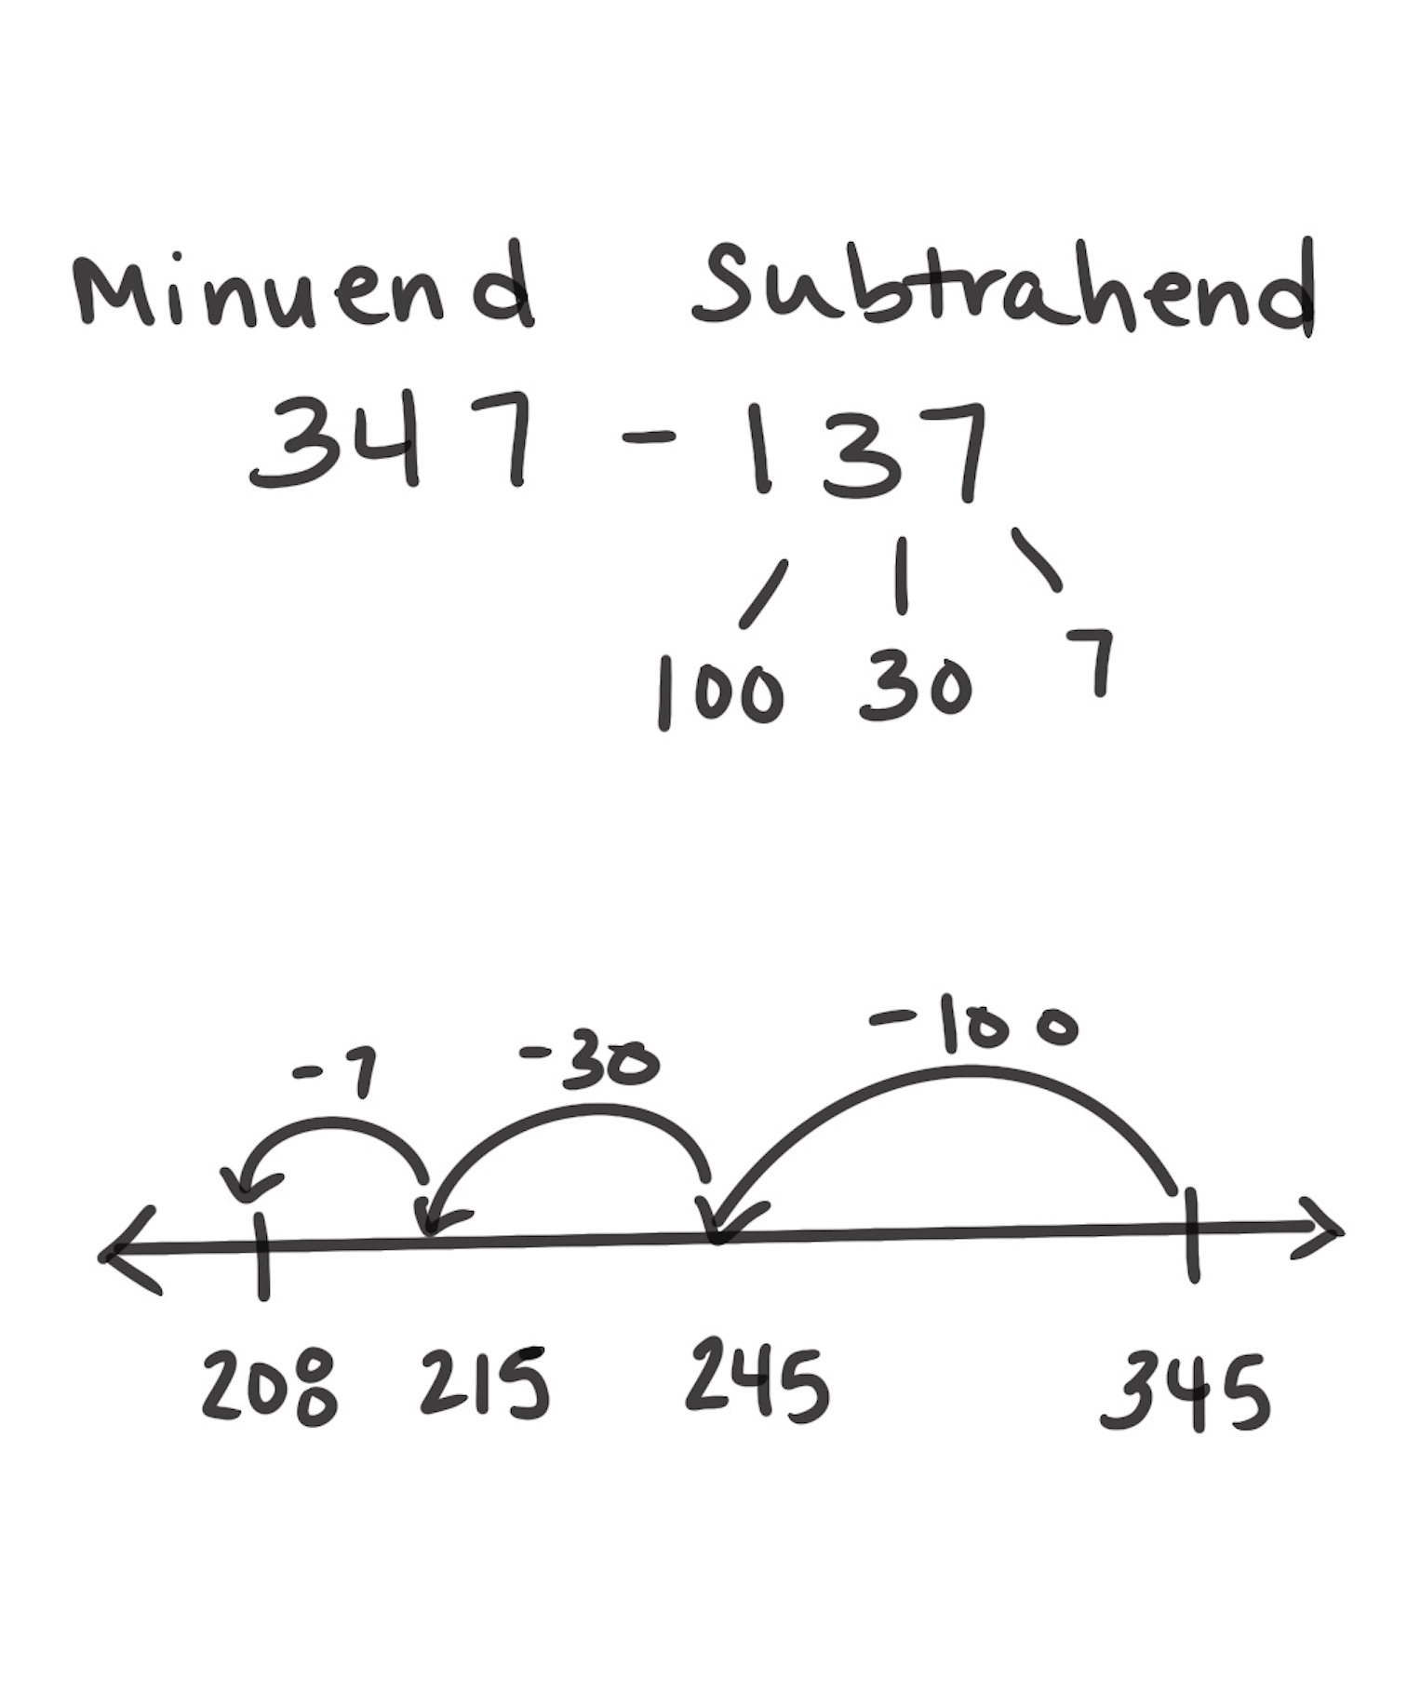
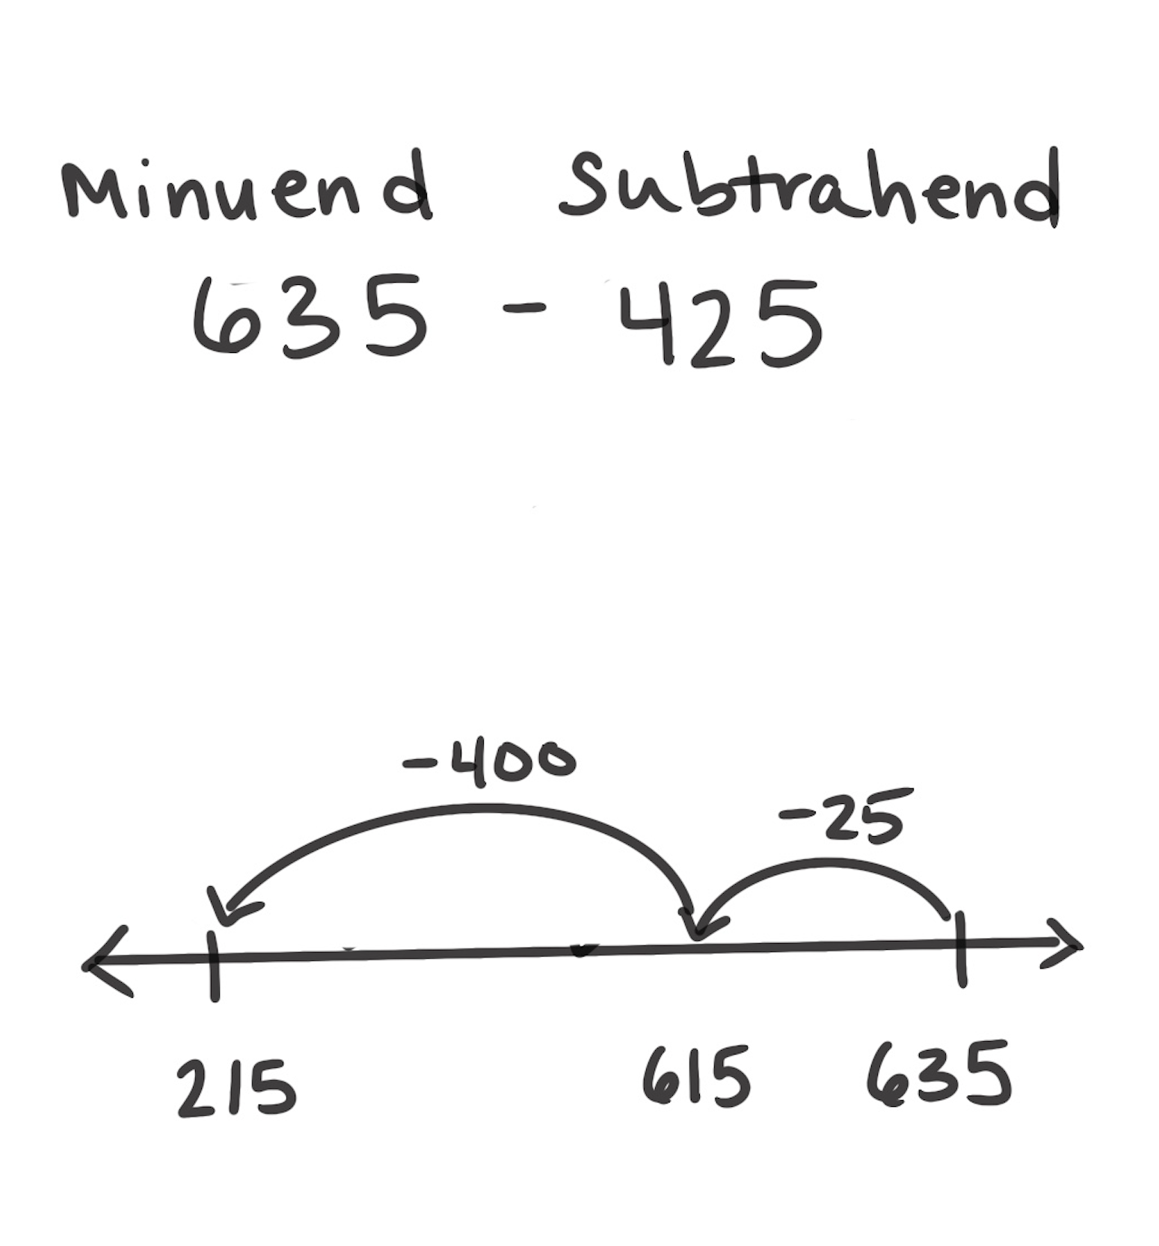
Count Back Strategy
How It Works: To subtract, we can break apart the subtrahend (second number) and count back from the minuend (first number).
Break apart the subtrahend (the second number) into easy chunks.
Count back from the minuend (the first number) by the chunks.
The last count is the answer.
The left example shows how 137 can be broken into 100, 30, and 7. Note that those chunks can be counted in any order.
The right example shows how the person counts back 25 first and then 400.
When It’s Useful: Count Back is useful when the number being subtracted is small. Count Back is also useful when the difference between the two numbers is small.

