Slide 1
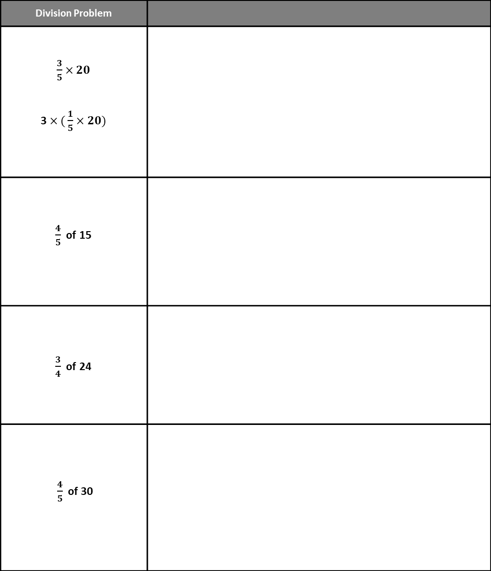
Candy Trays - Break Apart by Factors
Directions: Break apart the fractions as factors showing the part of the set as the product.
Division Problem
$\frac{3}{5}$ $×20$ 3$×($ $\frac{1}{5}$ $×20)$
$\frac{4}{5}$ of 15
$\frac{3}{4}$ of 24
$\frac{4}{5}$ of 30

