Slide 1
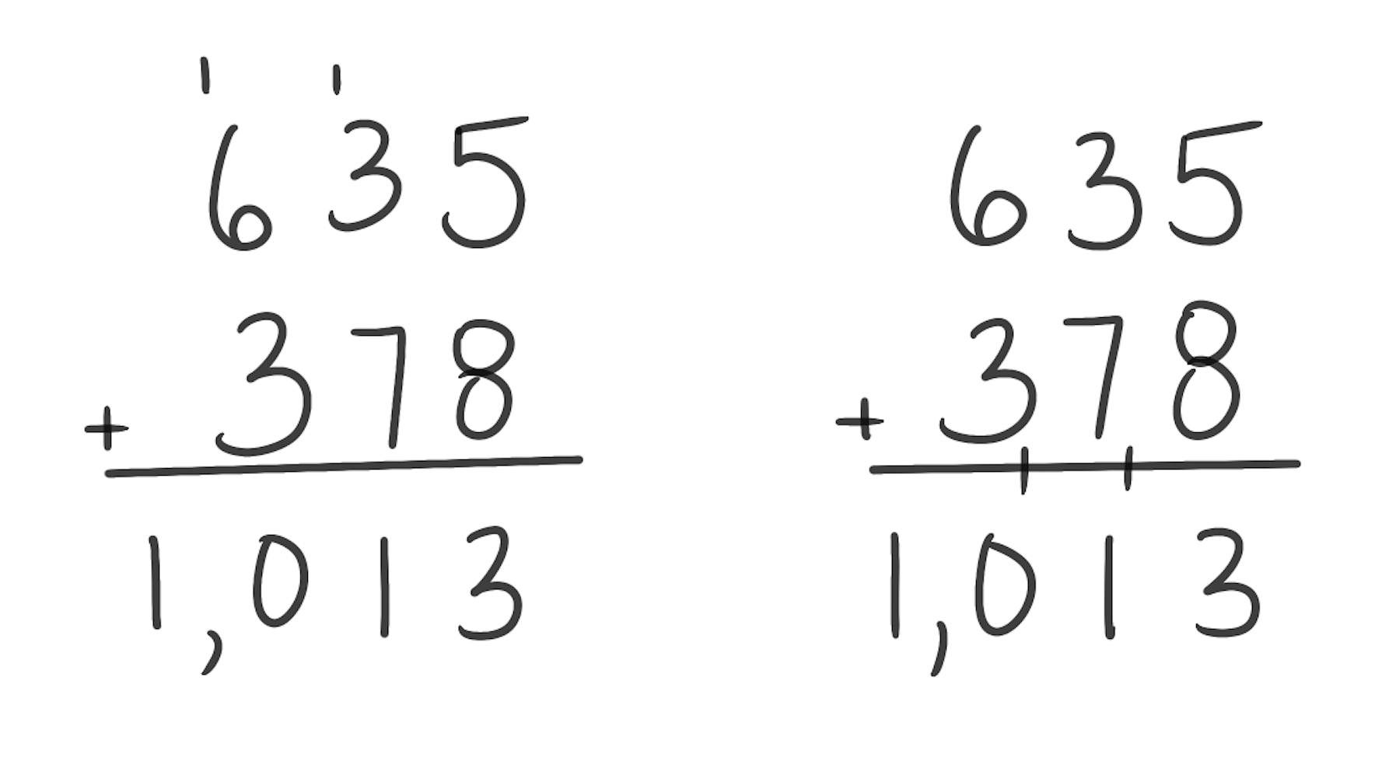
$
Standard Algorithm for Addition
How It Works: Addends are aligned vertically by place value. Each place value is added from right to left. When a sum is more than 10, it is regrouped.
Regrouping can be recorded above the addends or below them.
In the examples, 5 + 8 = 13. Since 13 is more than 10, it needs to be regrouped. Record the 3 in the ones and regroup the 1 ten. That 1 ten added to 3 tens and 7 tens equals 11 tens or 1 hundred and 1 ten. Record the 1 ten and regroup the 1 hundred.
Things to Remember:
Place values are being added. In 635 + 378, 3 tens are being added to 7 tens.
Knowing when to use an algorithm is just as important as knowing how to use an algorithm. Problems like 200 + 300 do not need an algorithm for solving.
Students should always think about what is a reasonable answer. In this problem, an answer around 1,000 would be reasonable because the problem can be thought of as 600 + 400. Students may also estimate 900 because the problem can be thought of as 600 + 300.

