Slide 1
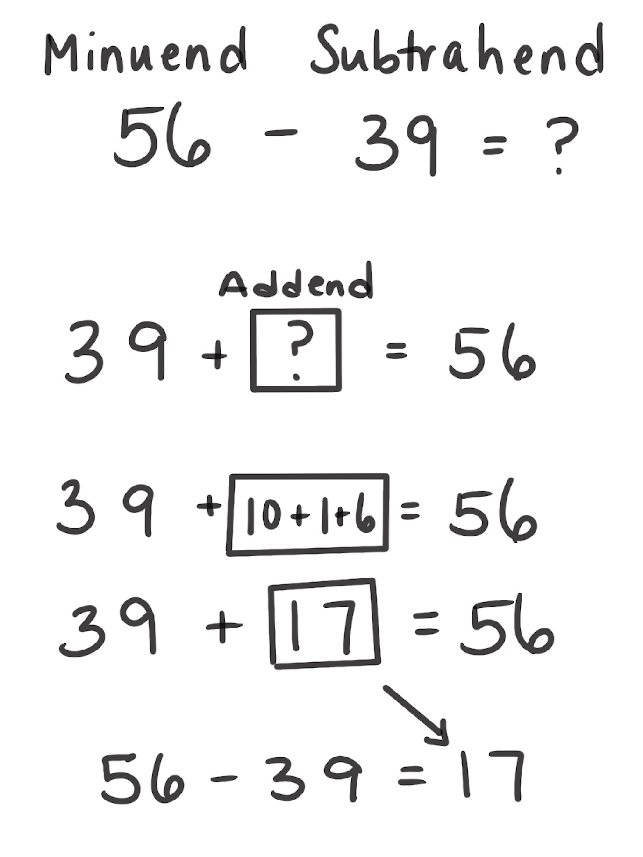
Think Addition Strategy for Subtraction
How It Works: We can use the relationship between addition and subtraction to solve subtraction problems. Subtraction is also a missing part addition problem.
Rethink the subtraction problem as a missing part addition problem.
Add up to find the missing part.
The missing part is the answer to the subtraction problem.
For example, 56 – 39 can be thought of as 39 plus something is 56. We can count up from 39 to 56, which is 17. So, 56 – 39 = 17.
When It’s Useful: This strategy is useful when numbers are close together or when the Count Up or Count Back strategy isn’t extensive.

