Slide 1
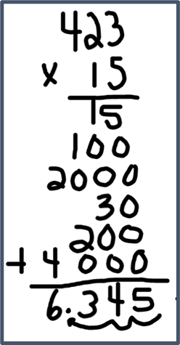
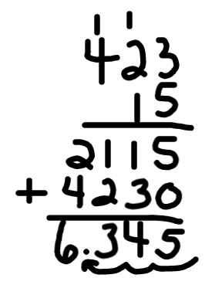
Standard Algorithm for
Multiplying Decimals
What it is: The standard algorithm is a digit-based procedure for multiplying multidigit factors. It starts with the digits in the ones place and continues to multiply digits by place value from left to right.
Let’s consider 4.23 × 1.5.
What it sounds like: | What it looks like:
First, if we estimate the product, we see it will be close to 4 × 1.5, which is 6. Then work out the whole-number version of the problem 423 × 15 and use the estimate to determine where to place the decimal point. The first example lists the 5 products separately. This can avoid making mistakes with the “tick marks.” The second example shows the common practice of recording “tick marks” to show regrouping. It is less writing, as you can see. Either method takes about the same amount of time, so if one seems complicated, or is causing errors, use the other one. When it’s useful: The algorithm for multiplying fractions is useful when there isn’t a mental strategy or other shorter method⎯and when you don’t have a calculator handy!

Slide 2
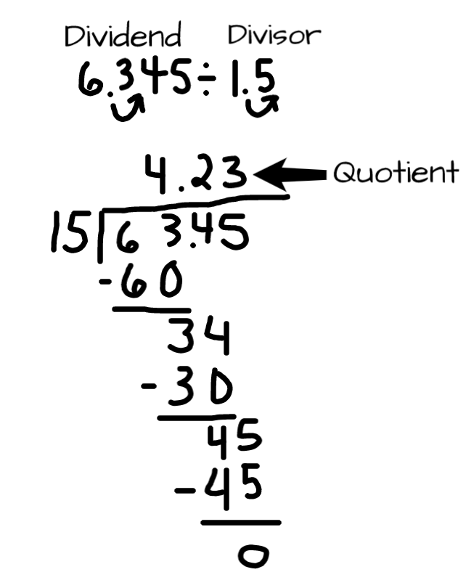
Standard Algorithm for
Dividing Decimals
What it is: The U.S. standard algorithm for division is a repeated process of seeking the largest possible partial quotient for each place value, subtracting, and repeating for the next smaller place value.
What it sounds like: What it looks like:
I will begin by converting the divisor into a whole number by moving the decimal point to the right. I move the decimal point in the dividend by the same number of places as the divisor. So 6.345 divided by 1.5 becomes 63.45 divided by 15.
I write the division in standard form. I think of the greatest multiple of 15 that is less than 63. That is 4. I record the 4 as part of my quotient, then subtract the 60 (15 × 4). Subtracting gives me 34. The closest I can get to 34 is 15 × 2. That’s 30. Again I record the quotient (2) and subtract. Now we bring down the 5 to make 45. I know that 15 × 3 is 45. I record the 3, and do my final subtraction to show that the remainder is 0.
When it’s useful: The algorithm for dividing fractions is useful when there isn’t a mental strategy or other shorter method⎼and when you don’t have a calculator handy!

