Slide 1

Breaking it Down
Decomposing at all Levels
Ryan Dougherty
Jeff Gobin
Kara Rihn

Slide 2

Goals
What is decomposing?
Whole Numbers
Beyond Whole Numbers
Notes:
Definitions and Misconceptions
Take a look at decomposition in whole numbers - different ways to show it to students.
Why do we teach decomposition? Is it only to see how whole numbers can be broken apart? Seems silly to only use it for place value.

Slide 3

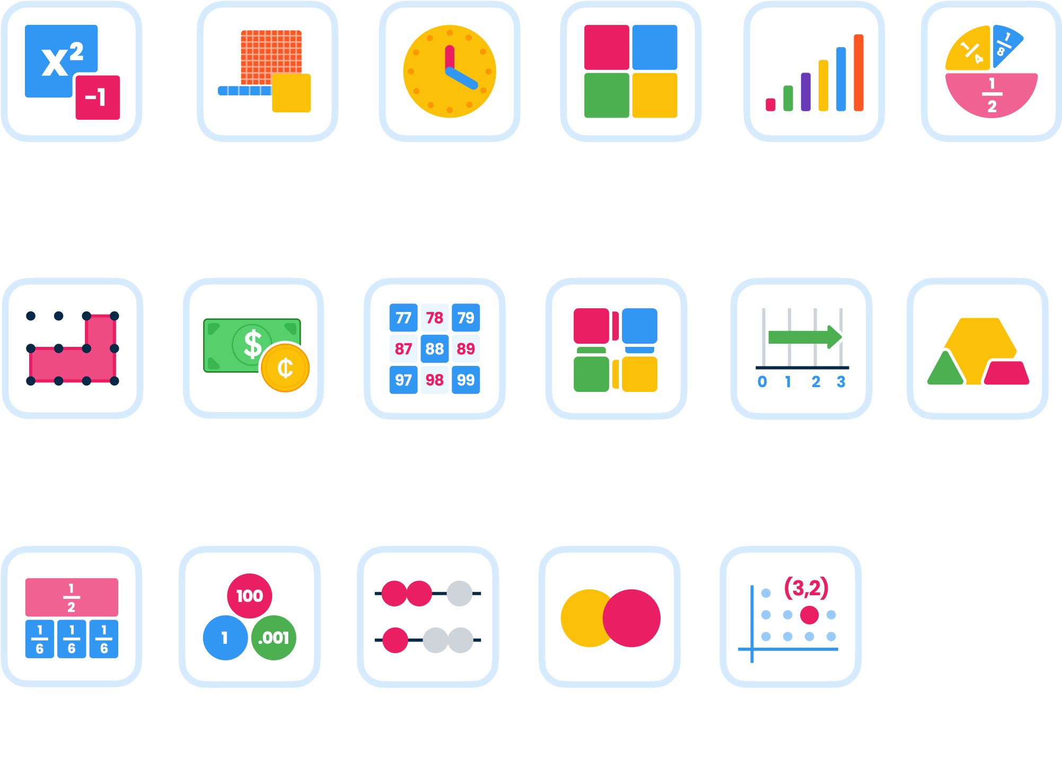

All the Most Popular Digital Manipulatives
Notes:
What is Brainingcamp.
We will be using it today to participate in activities around decomposition, this will be interactive.
Pause the video to try the problems yourself.

Slide 4
Participate today using Brainingcamp
Go to www.brainingcamp.com
Click on Sign In
Username - BMM2026
Password - BMM2026
Notes:
What is Brainingcamp.
We will be using it today to participate in activities around decomposition, this will be interactive.
Pause the video to try the problems yourself.

Slide 5


Entering Share Codes
Notes:
We will be solving many problems today. Each one has a “Share Code” to take you to the problem. This is where you enter the code.

Slide 6

Decompose: Separate a whole into parts.
Decomposition of numbers: The taking apart of numbers into two or more parts.
Students who can decompose numbers and see the relationship between a whole number and its parts develop computational fluency and have many strategies for solving arithmetic questions mentally.
The Ontario Curriculum Glossary
Notes:
Ontario standards have these definitions and description in their glossary.
Focus on the many strategies - decomposing is the core to many strategies and usually make problems easier to solve.

Slide 7

Common Misconceptions
Believing Each Number is a Single Entity
Children often assume that a number is just one unit instead of a collection of smaller numbers.
Seven is 7.
3 + 4 or 2 + 5 are not 7
Notes:
Believe Each Number is a Single Entity - It will take time to break this misconception, so be patient and use hands-on activities to help them realize that numbers can be broken apart into smaller numbers.
Every number can be broken apart, no matter how big or small. This isn’t solely a whole number skill. Fractions, decimals, ratios, measurements, time, area, geometric shapes and more can all be broken apart.

Slide 8
Common Misconceptions
Thinking There is Only One Way to Decompose Numbers
Once they know they can decompose, they often believe there is one “correct” way
9 is made up of 5 and 4
But also, 1+8, 2+7, 3+6, 4+5, 6+3…
and
4.5 + 4.5, 2.7 + 6.3…
Notes:
8 ⅗ + ⅖, and it doesn’t always have to be broken in two. Sometimes it is better to break into many smaller parts. Nine is also - 2 + 3 + 4.
There are many ways to decompose a number, and depending on the problem they are solving, one might be better than another.

Slide 9
Common Misconceptions
Thinking you Must Have all the Parts to Build a Whole
When encountering problems with missing parts, they may be confused, believing you need to have all the parts in order to solve a problem.
7 + _ = 9
Decompose the number 9 to solve the problem.
Notes:
Using understanding of decomposing to compose a number!

Slide 10

Whole Number Examples
Decomposing 10
Two Color Counters and Tens Frames - SEPRLDMR
Numbers to 999
Base Ten Blocks - 2GZ6NXUK
Numbers to 1,000,000
Place Value Chips - MYGRW3QC

Slide 11
Using Decomposition
Addition/Subtraction
247 + 126 - VD29ZQ6Q
2,687 - 1,485 - LXT7MU4C
Multiplication
22 x 7 - D4Q7E3C7 (Distributive Property)
12 X 23 - 6X8PUTW5
Division
1254 ÷ 3 - MHYMC19L
Notes:
Now that we have spent so much time teaching kids numbers can be broken down - let’s put that learning to use in other situations.

Slide 12
Fraction Examples
Addition and Subtraction
7/10 + 5/10 and 1 2/5 - 4/5 - QWQ47SBU
Multiplication and Division
2 2/10 X 3 - GTEX1AZ3
2 1/2 ÷ 1/4 -F81VPTYA
Notes:
Now that we have spent so much time teaching kids numbers can be broken down - let’s put that learning to use in other situations.
For subtraction - we can break into 1 - ⅘ + ⅕. We then get the equation - ⅘ + ⅕ + ⅖ - ⅘. The ⅘ cancel out, leaving ⅕ + ⅖.

Slide 13

Using Decomposing in the Real World
Cooking - CXRYGLUL
Movie Times - 7YG1FQW2
Area - W6KWF9RW
Lunch Money - 61FEAPTZ (GHNLPJZH - Canadian)
Miles to Go - 79JHRWJK

Slide 14
Free Classroom Trial
Step 1: Go to www.brainingcamp.com
Step 2: Click on ‘Redeem Code”
Step 3: Enter the code BMM2026
6 Month License
Add students in ‘Accounts’ tab.
Notes:
If you don’t have Brainingcamp - use this code for an extended trial. If you don’t want to use Brainingcamp, you can use physical manipulatives too.

Slide 15


Thank You!
Ask Me Two Questions
ryan.dougherty@brainingcamp.com

