Slide 1
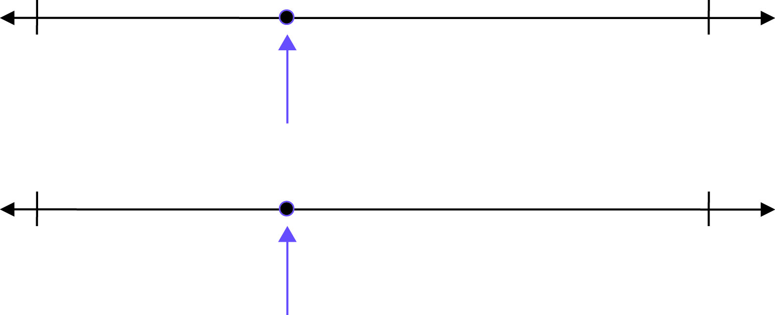
Where’s the Point?
What number is the arrow pointing to?
How do you know?
0
20
25
45

Slide 2
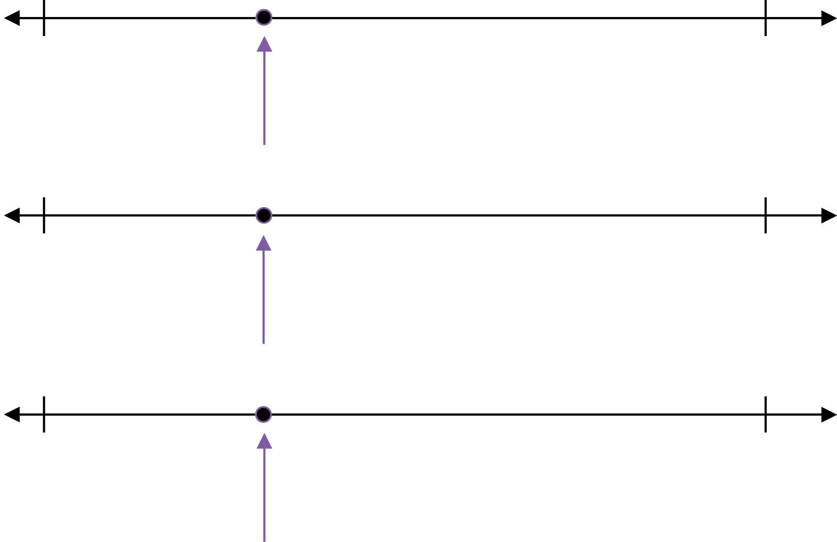
Where’s the Point?
25
35
125
135
805
905

Slide 3
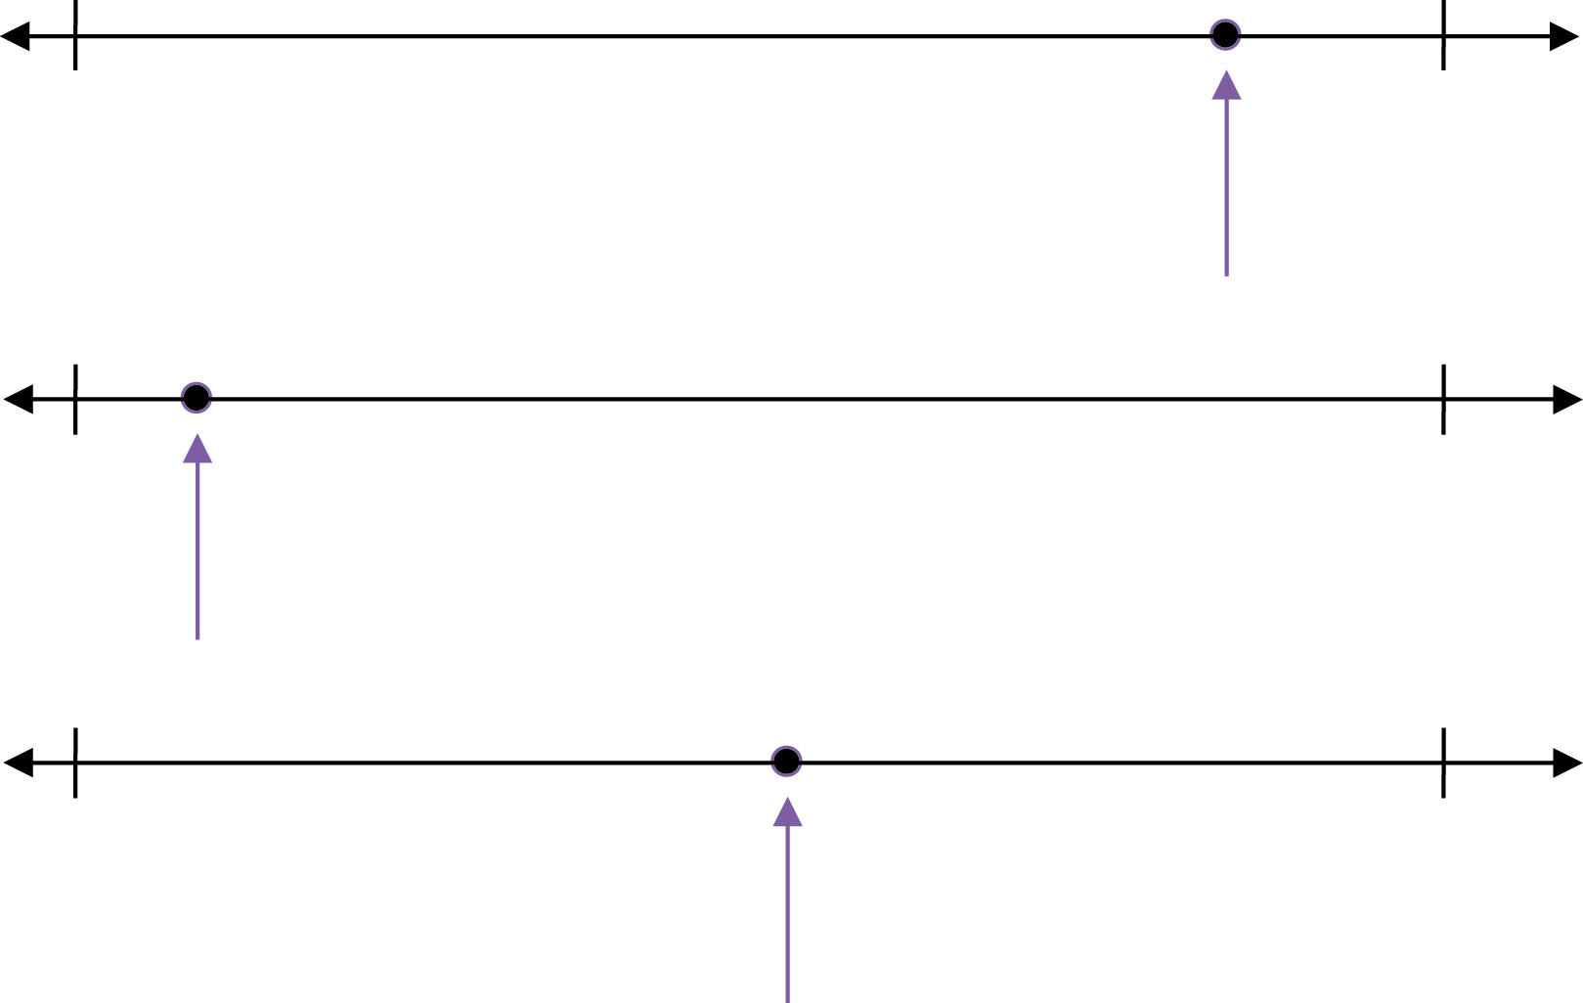
Where’s the Point?
40
60
55
75
25
75

Slide 4
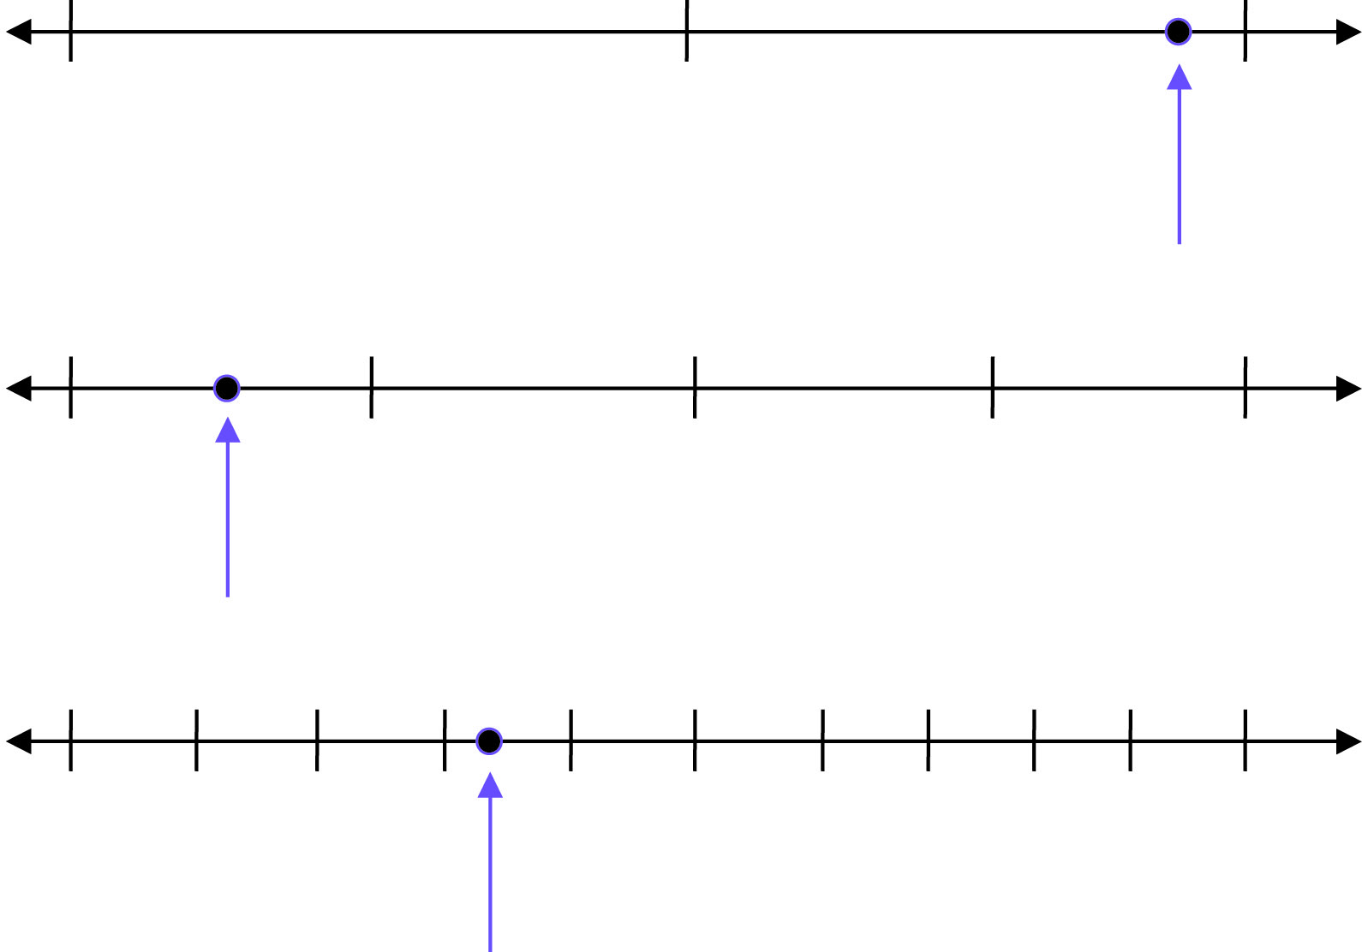
Where’s the Point?
25
35
120
200
805
905

Slide 5
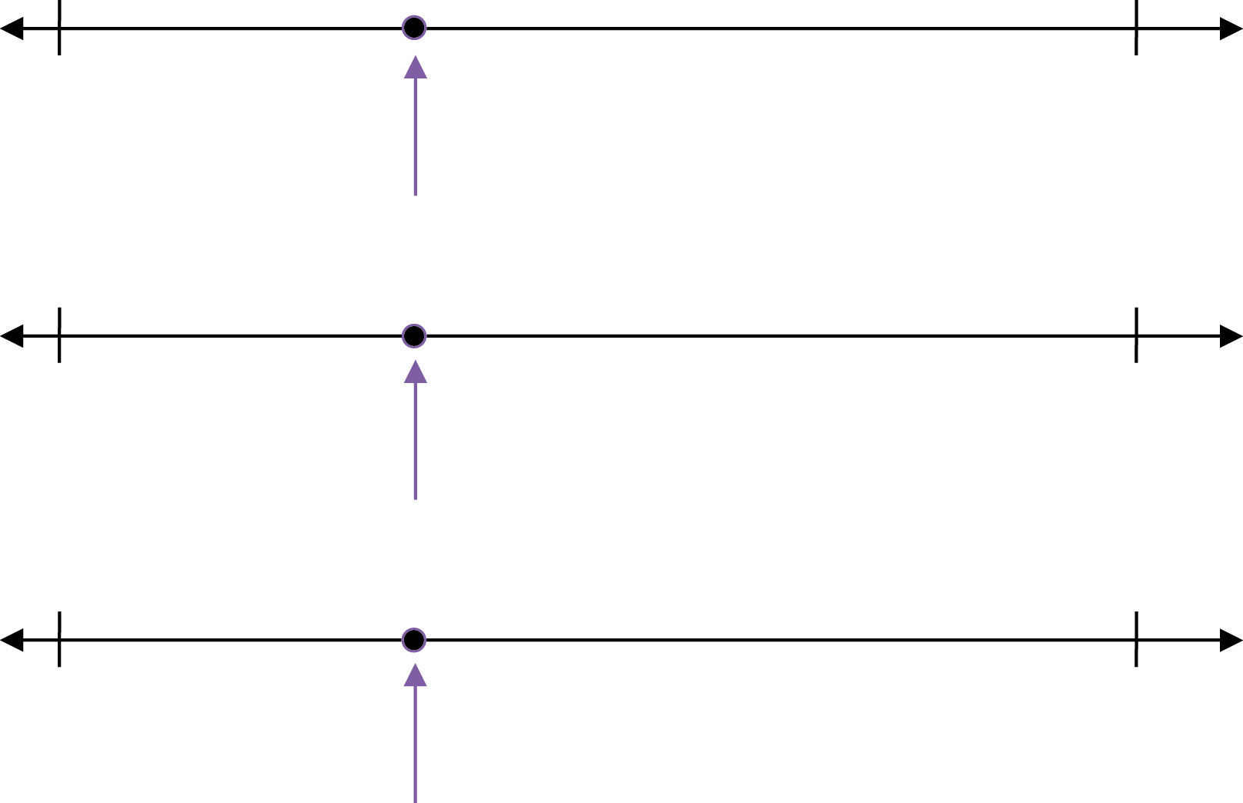
Where’s the Point?
0
1
0
2
7
8

Slide 6
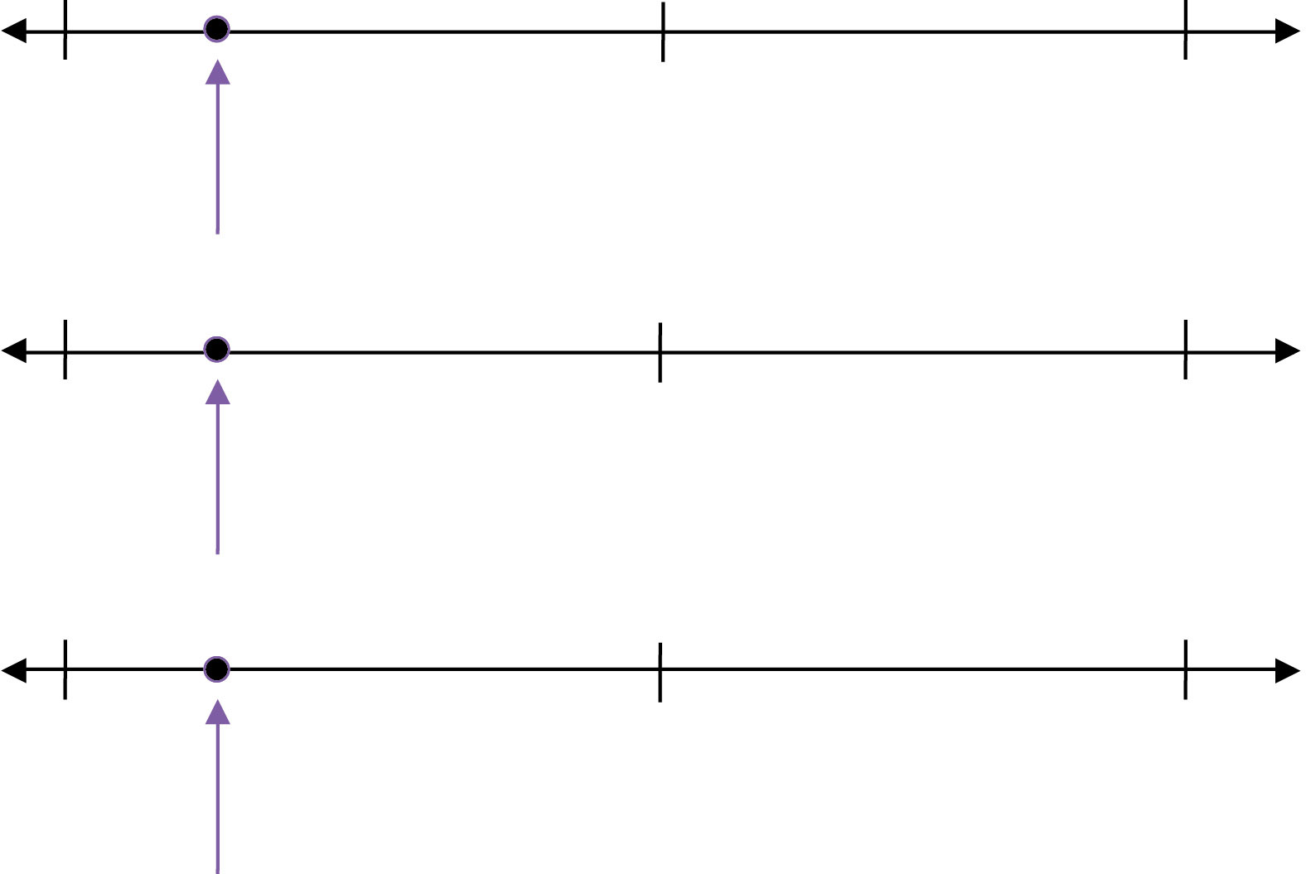
Where’s the Point?
300
400
3,000
4,000
30,000
40,000

Slide 7
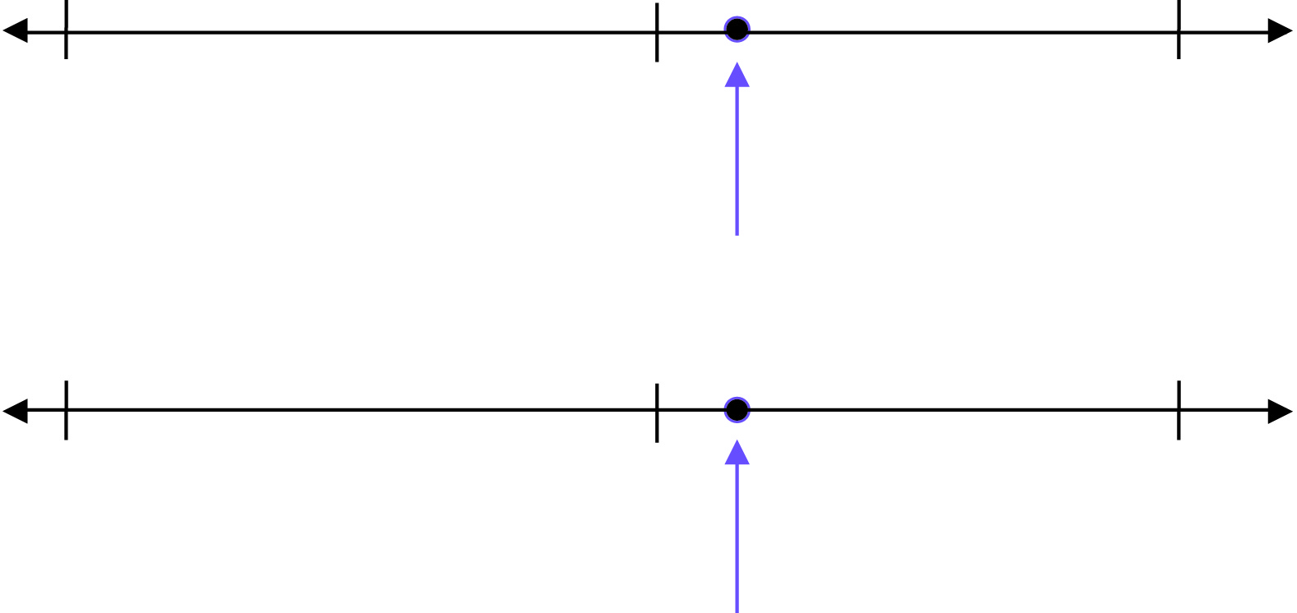
Where’s the Point?
12,500
12,600
1,250
1,260

Slide 8
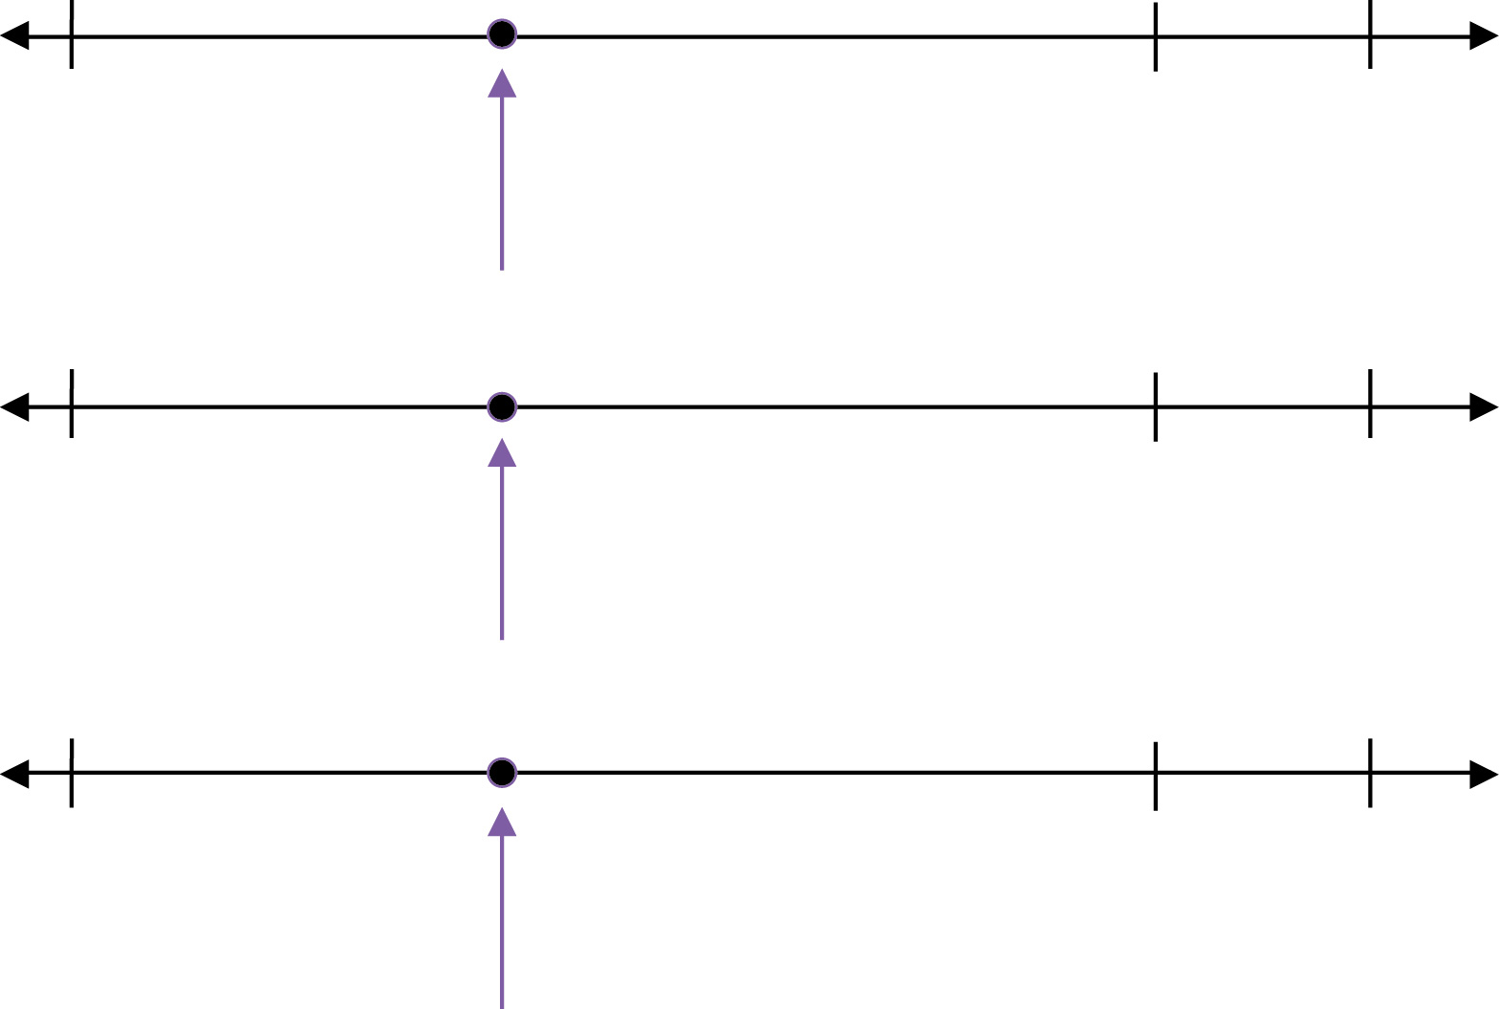
Where’s the Point?
73
80
74
81
75
82

Slide 9
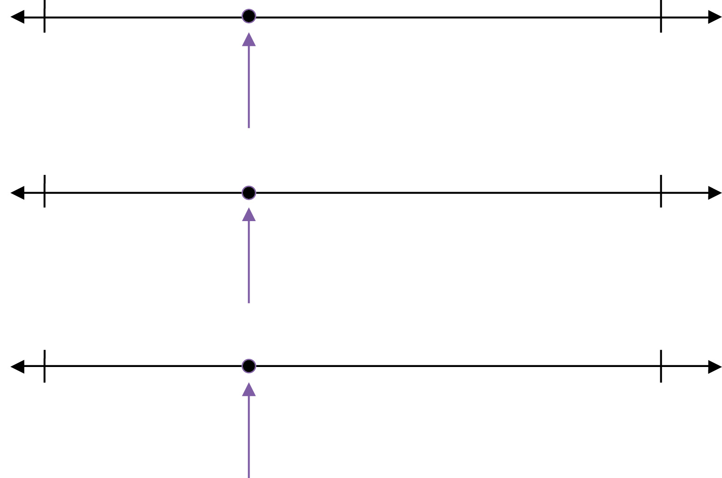
Where’s the Point?
100
150
50
150
0
150

