Slide 1
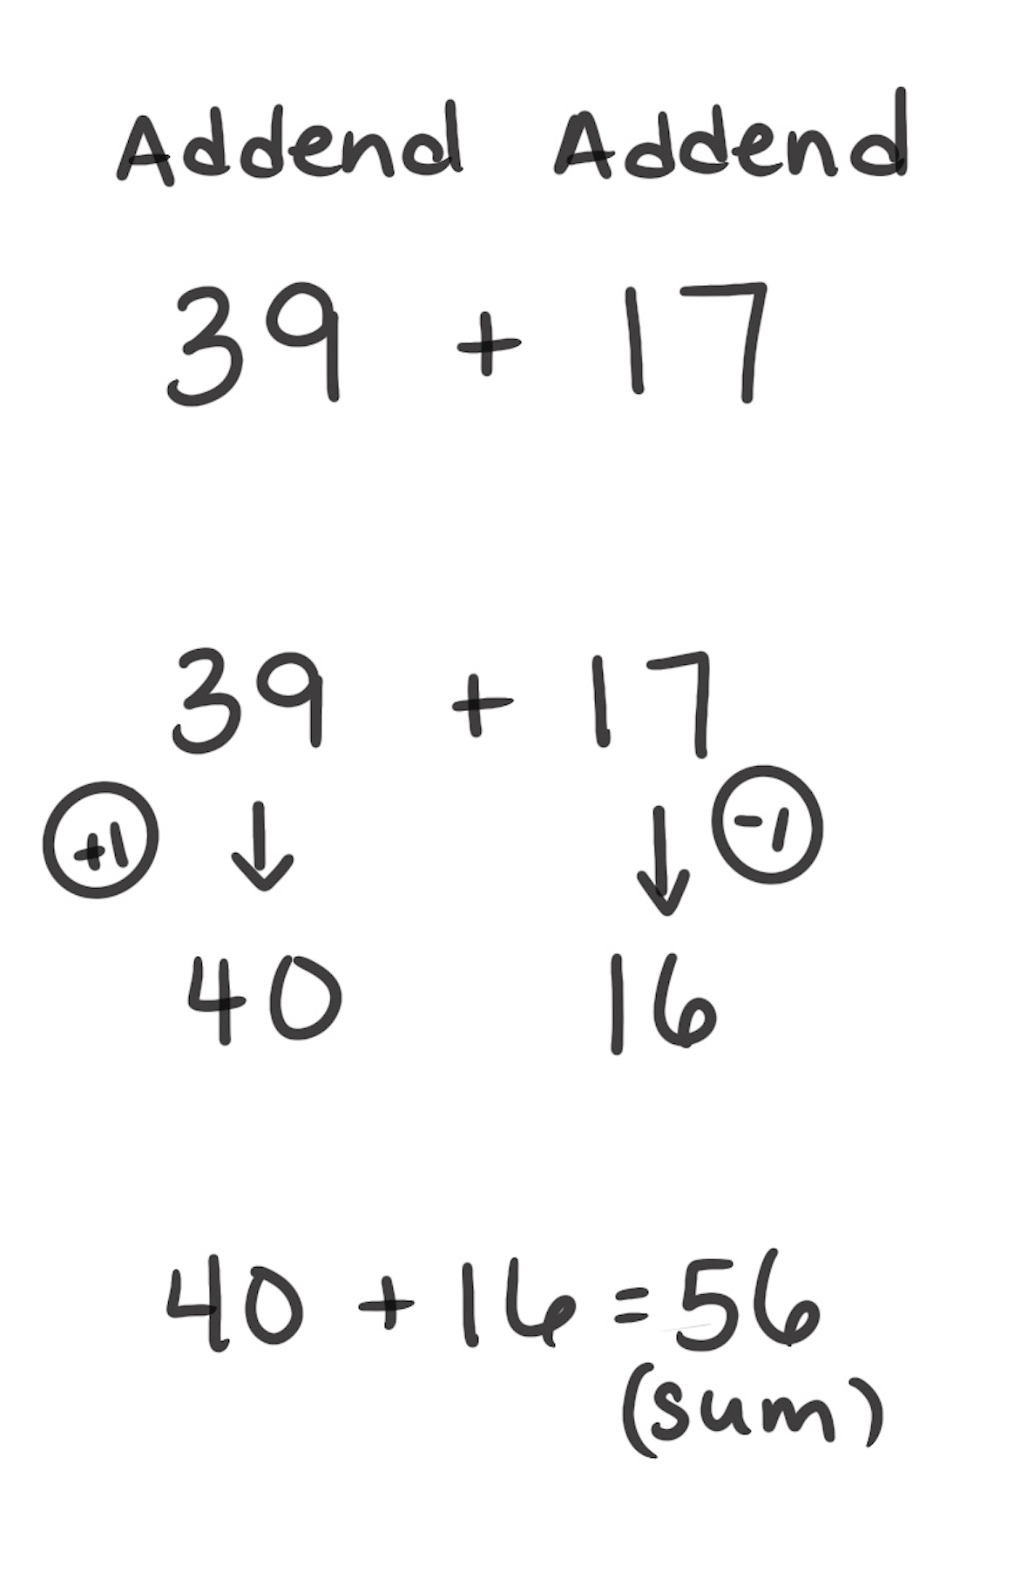
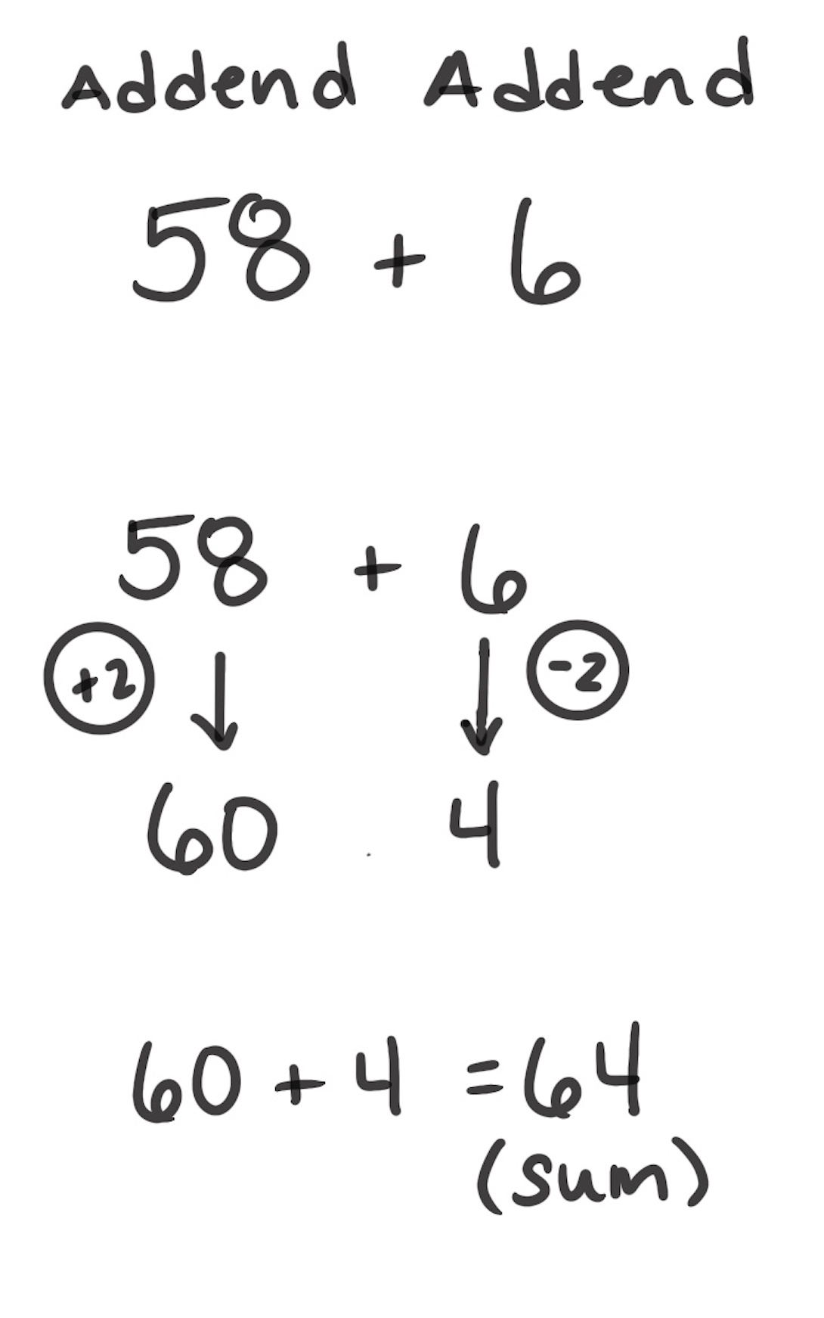
Make Tens Strategy
How It Works: We can break apart one addend and give some to another addend to make a 10.
Choose which addend you find easy to make into the next 10.
Break apart the other addend. Give some of that number to the other number.
The other number will now make a 10.
Add the parts together.
In the left example, 39 is close to 40. To make it a 40, you break apart 17 into 1 and 16. Use 1 and add it to the 39 to make 40. Now add the 16 you have left to the 40. 39 + 17 becomes 40 + 16.
In the right example, 58 is close to 60. To make 60, you take 2 from the 6. Then add that to the 58. The new number sentence is 60 + 4. 60 + 4 = 64
When It’s Useful: Make Tens is useful when adding 2 two-digit addends or a two-digit addend and a one-digit addend. Remember that either addend can be made into the next 10.

