Slide 1
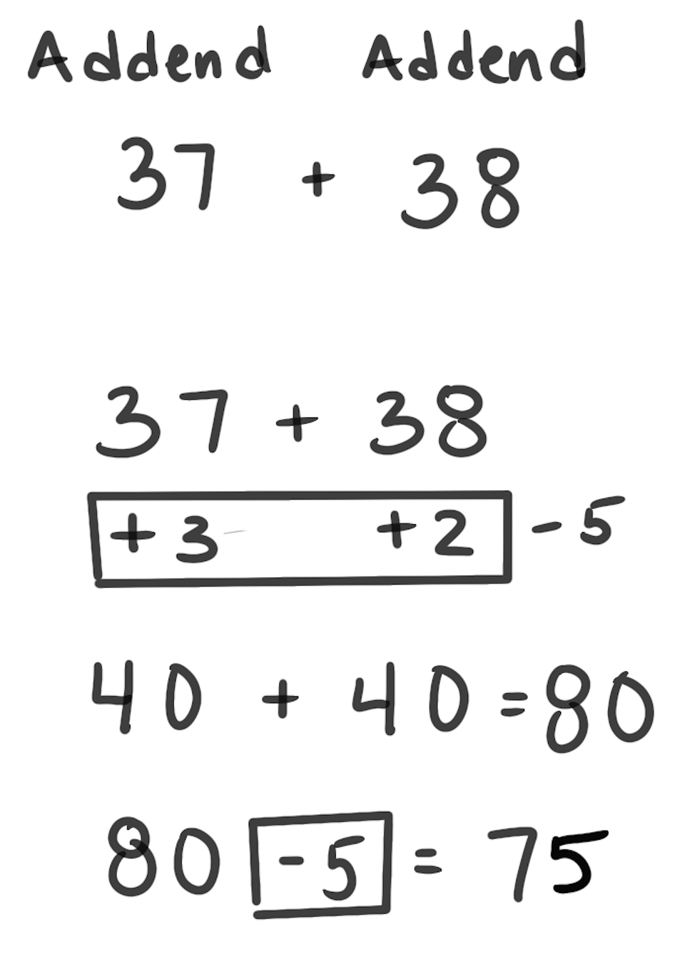
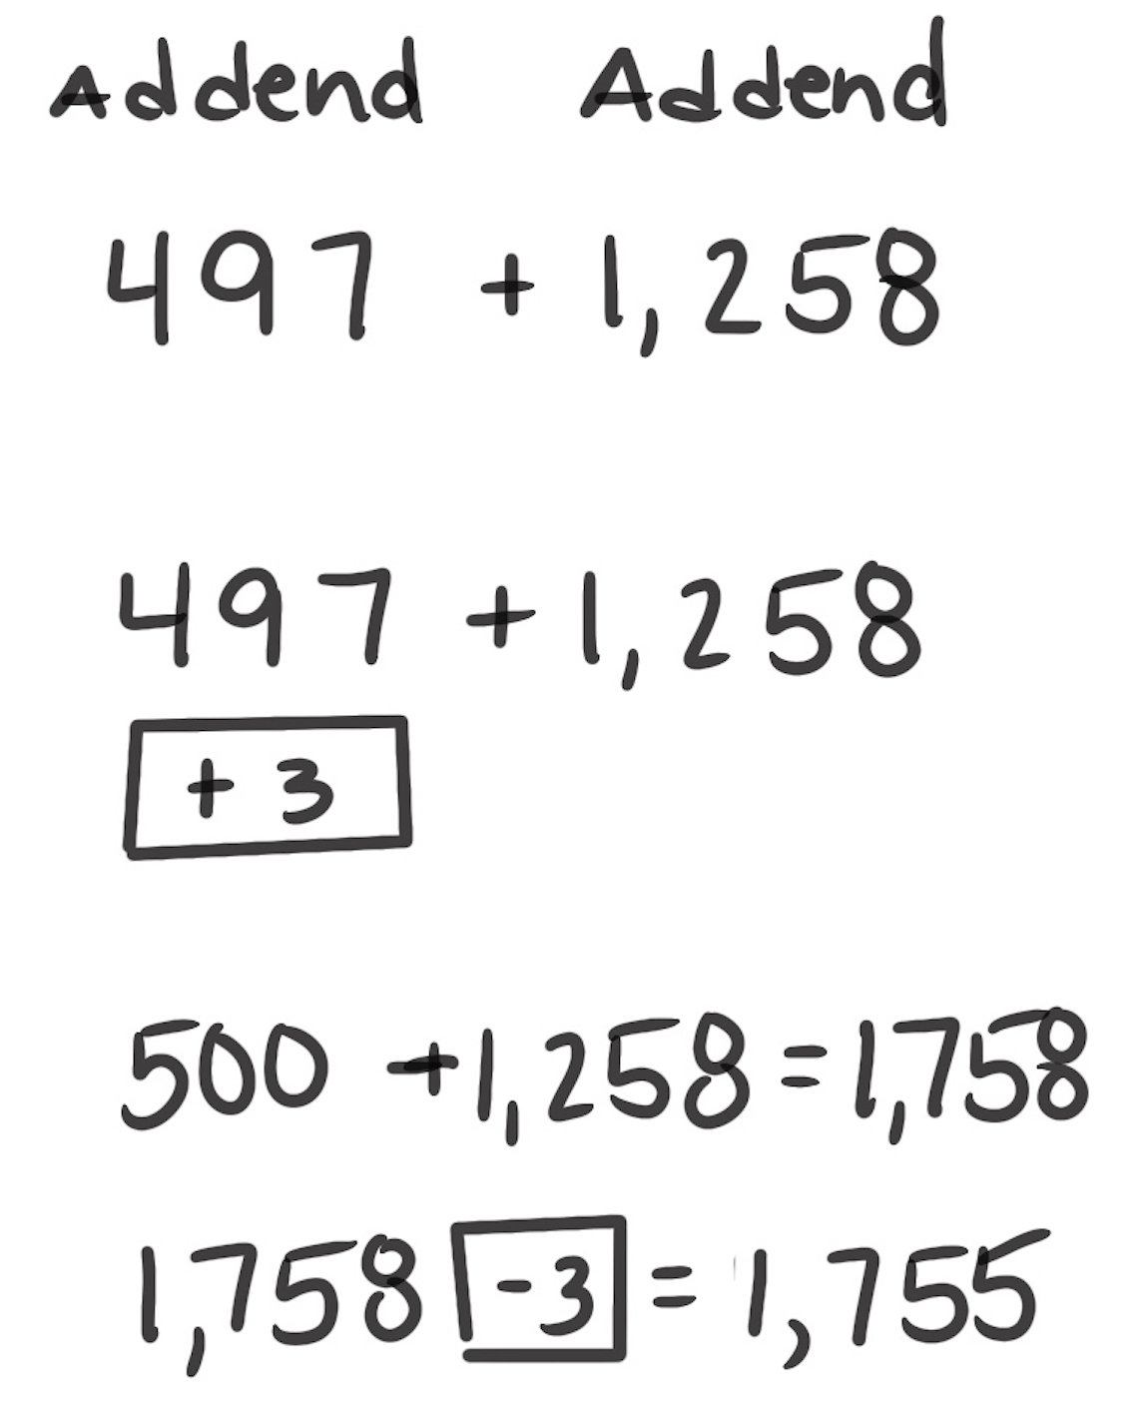
Compensation Strategy for Addition
How It Works: We can adjust numbers to make them easier to add. After we add the easier numbers, we can “undo” our adjustment.
Identify an easier problem.
Modify the original problem.
Solve the new problem.
Compensate for how the original problem was modified.
The left example shows that 37 + 38 can be thought of as 40 + 40. We would add 3 to 37 to make it 40. Then we would add 2 to 38 to make it 40. When you combine the
40 + 40, it is an easier problem to add: 40 + 40 = 80. We added 5 (3 and 2) to make the easier problem, so we have to take away that 5 from 80.
The right example shows that for 497 + 1,258, we thought of 497 as 500. We added 500 + 1,258. Then we took 3 away.
When It’s Useful: This strategy is useful when one number (or both) is near a benchmark.

Slide 2
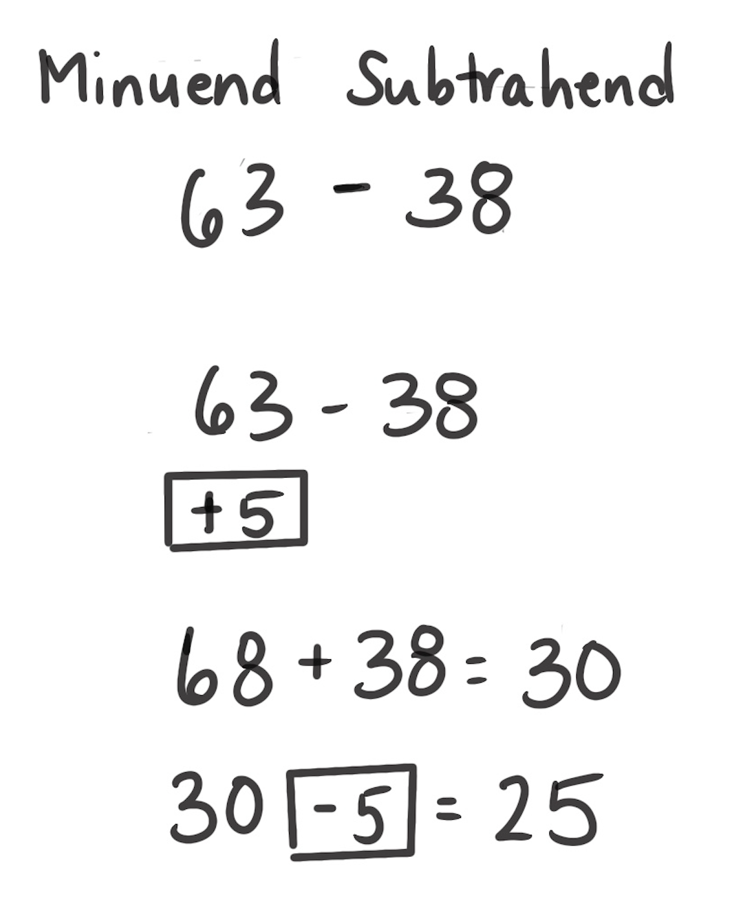
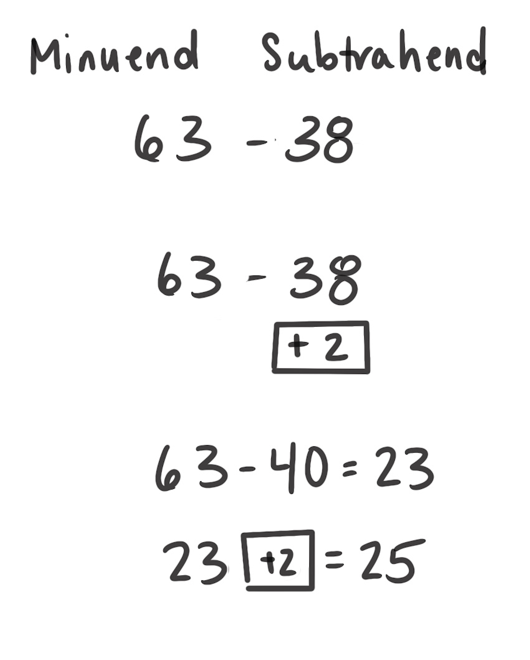
Compensation Strategy for Subtraction
How It Works: We can adjust numbers to make them easier to subtract. After we subtract the easier numbers, we can “undo” our adjustment.
Identify an easier problem.
Modify the original problem.
Solve the new problem.
Compensate for how the original problem was modified.
The left example shows that 63 – 38 can be thought of as 68 – 38, which is 30. 68 is 5 more than 63, so the difference of 30 is 5 more than the difference of the original problem (63 – 38). Or you can think of 63 – 38 as 63 – 40, which is 23.
The right example shows that we took 2 too much away so we have to “put it back.” 23 + 2 is 25. So, the original problem 63 – 38 = 25.
When It’s Useful: This strategy is useful when one number (or both) is near a benchmark. It is also useful instead of regrouping.

