Slide 1
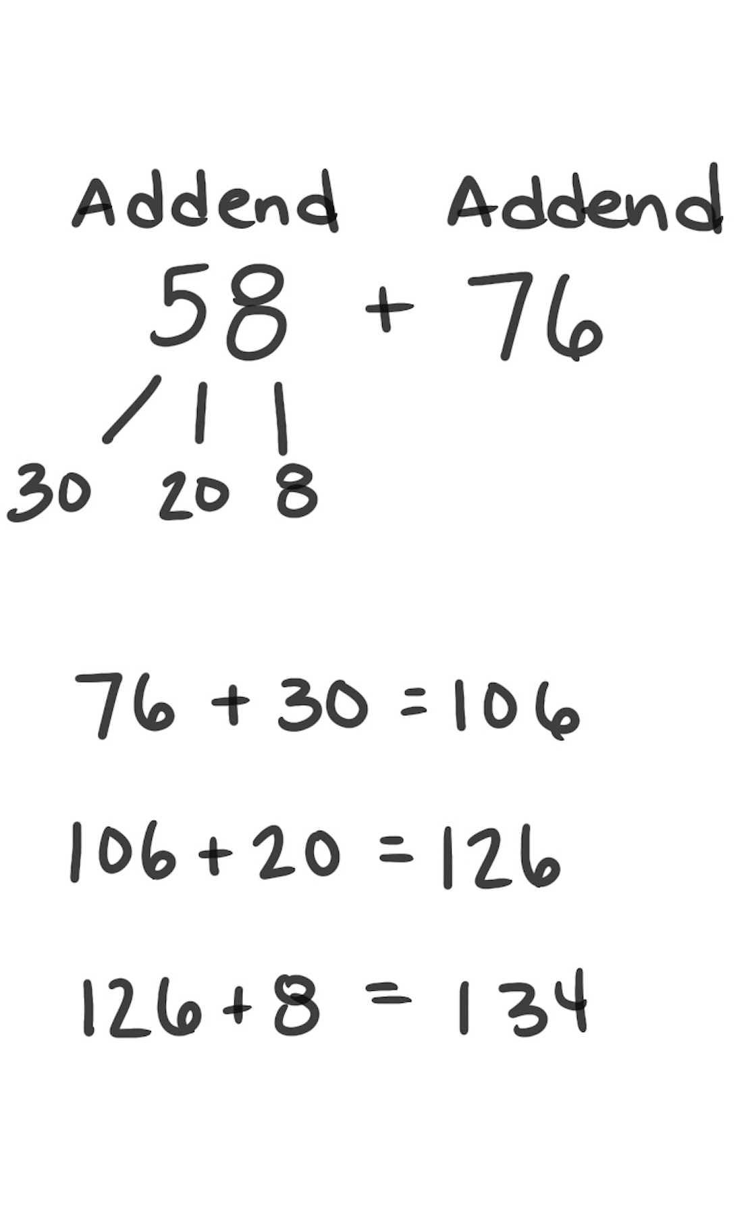
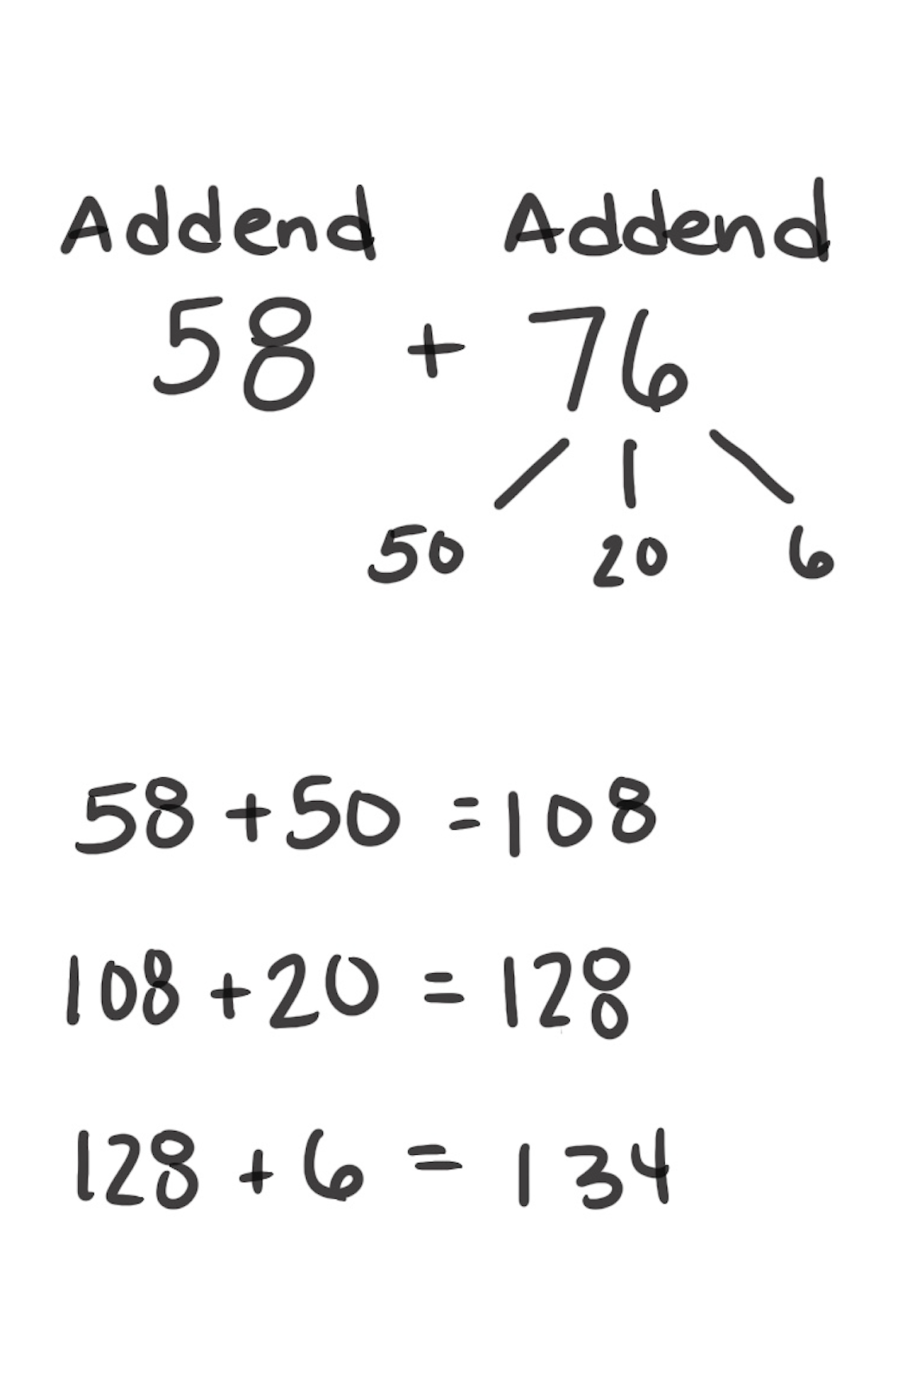
Count On Strategy
How It Works: To add, we can break apart an addend and count on from the other addend in chunks.
Choose which addend to break apart and which to count on from.
Break apart the addend into easy chunks.
Count on using the chunks you chose.
The left example shows that you can break apart 58 and count on from 76.
The right example shows that you can also break apart 76 and count on from 58.
When It’s Useful: Count On is useful when you can easily break apart one of the addends into convenient chunks. These addends are typically small (two, three, or four digits).

