Slide 1
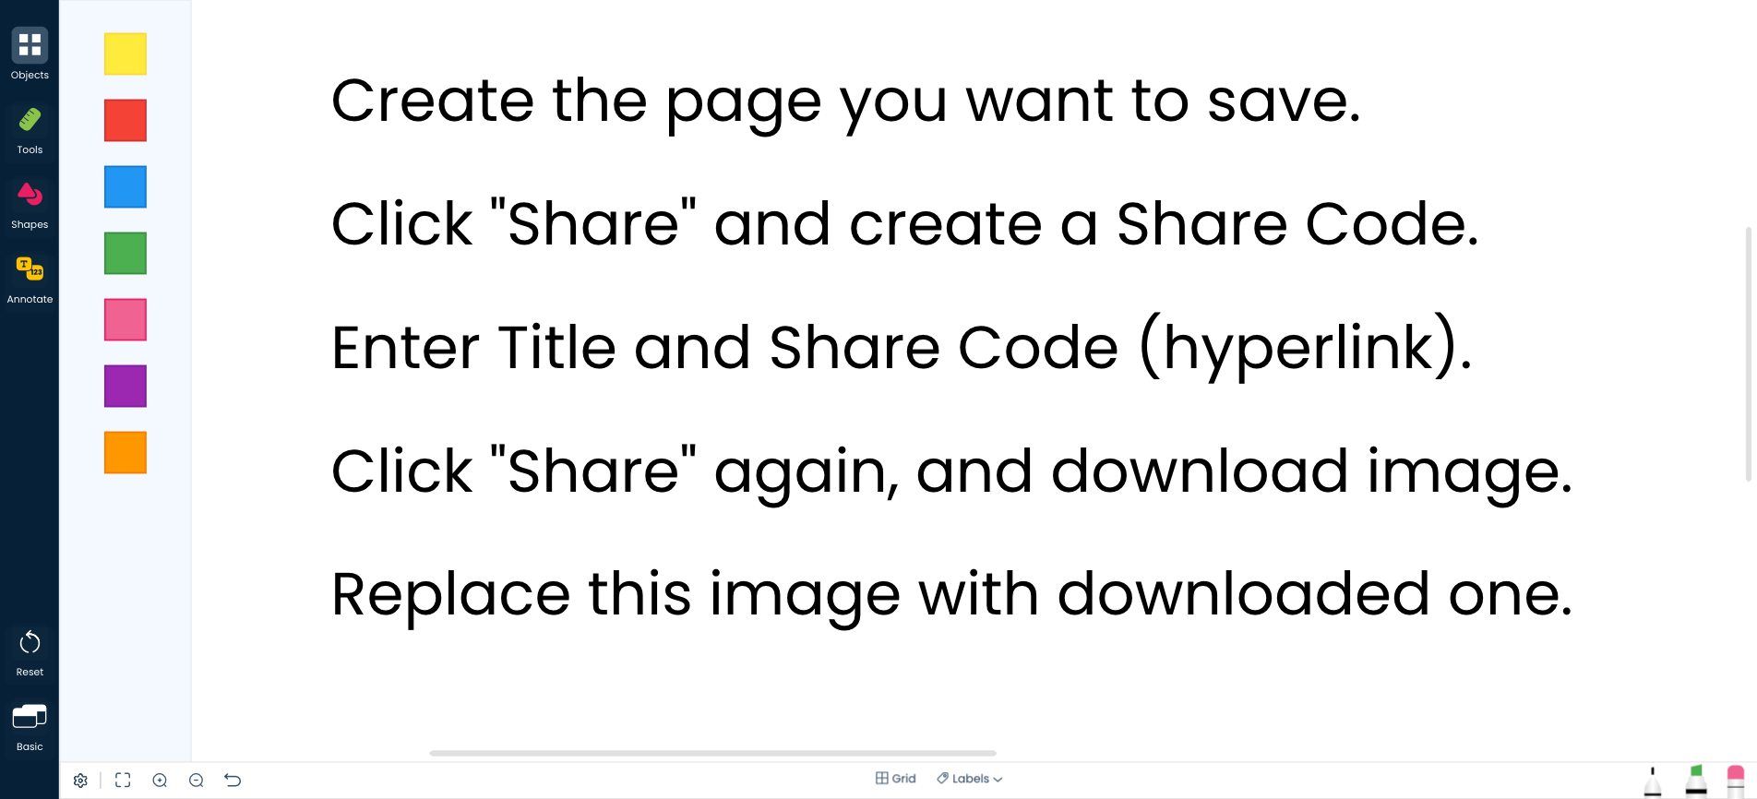
Title
Share Code

Slide 2
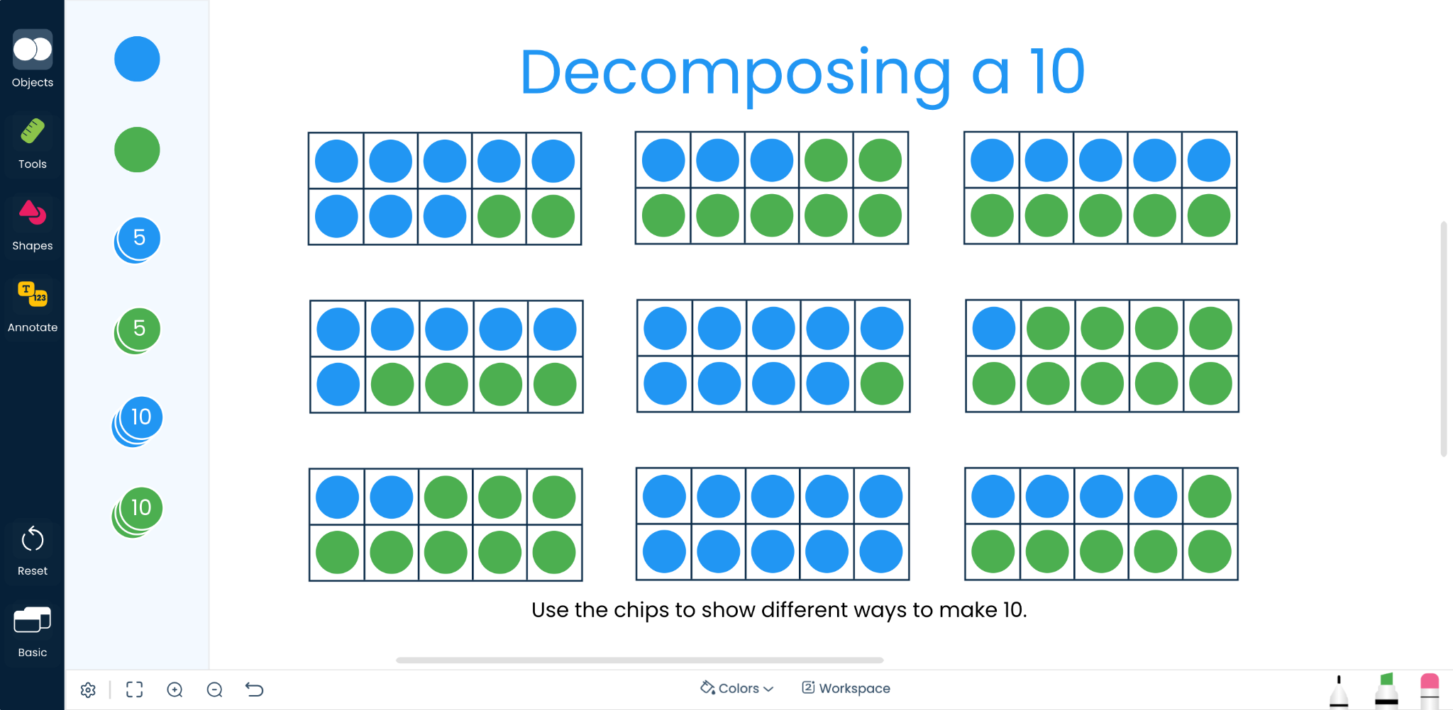
Decomposing 10
SEPRLDMR
Notes:
Manipulative - Two Color Counters
Workspace - Basic
Expectation -
Students will fill a 10 frame with a given number of blue counters, then completely fill the frame with green counters. Have a discussion about what each set of counters means.
Build Notes -
Added 10 frame from Tools
Built First one, eight others are for students to complete
Suggestions
Add a random number generator with a range of 1-9

Slide 3
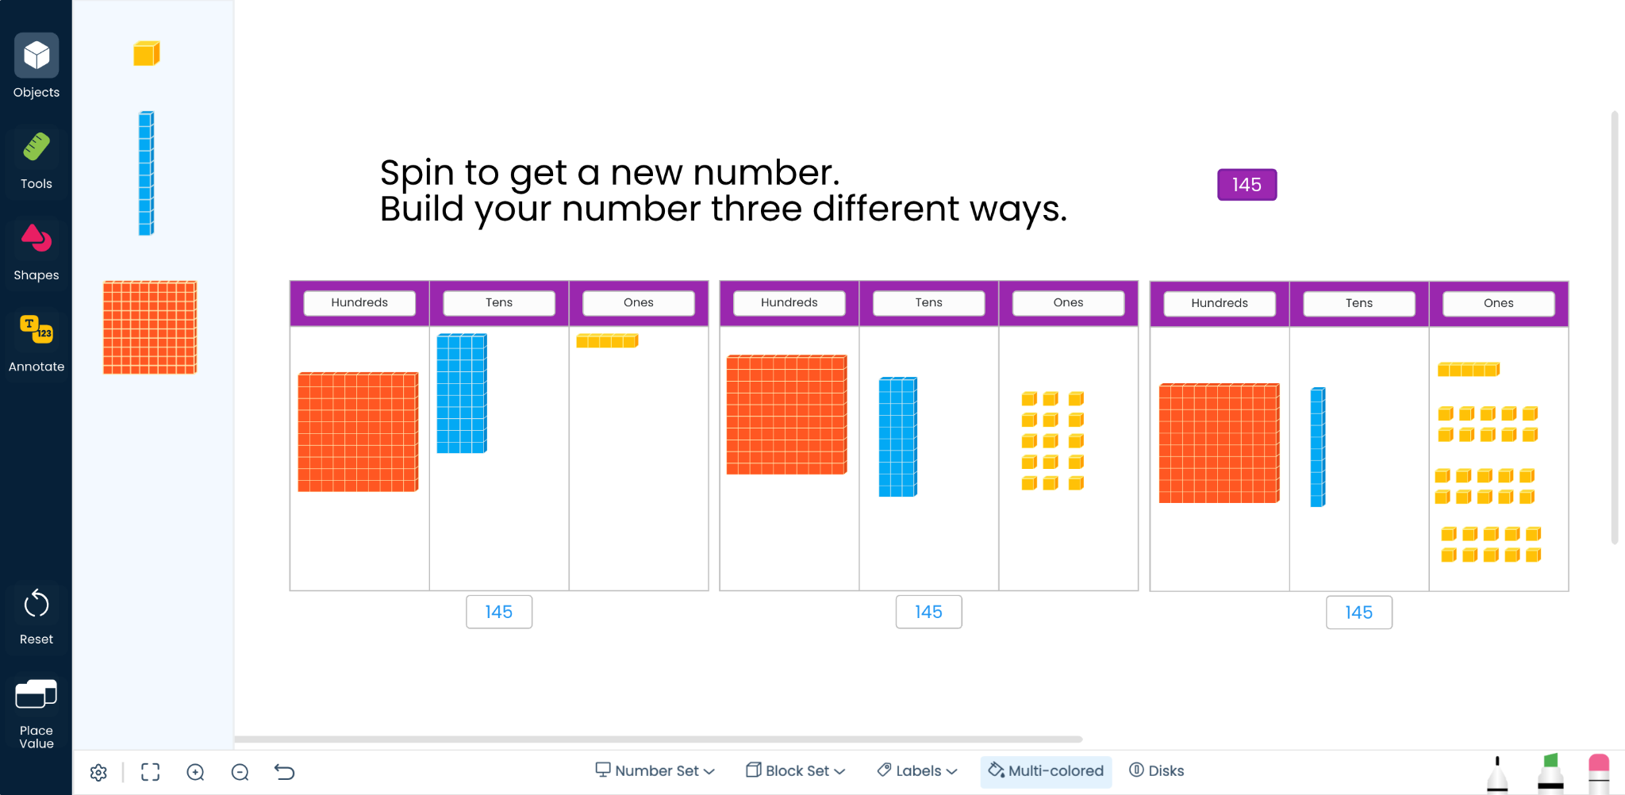
Numbers to 999
2GZ6NXUK
Notes:
Manipulative - Base Ten Blocks
Workspace - Place Value
Expectation - Students spin to create a new number and build it in the first place value chart. They then rebuild it two different ways in the other charts.
Build Notes -
Block Set was changed to “Flats”
Copied the Place Value Chart and resized to fit on screen
Random Number Generator set to 101 - 299 (any bigger and it would be hard to show) for larger numbers, try Place Value Disks.

Slide 4
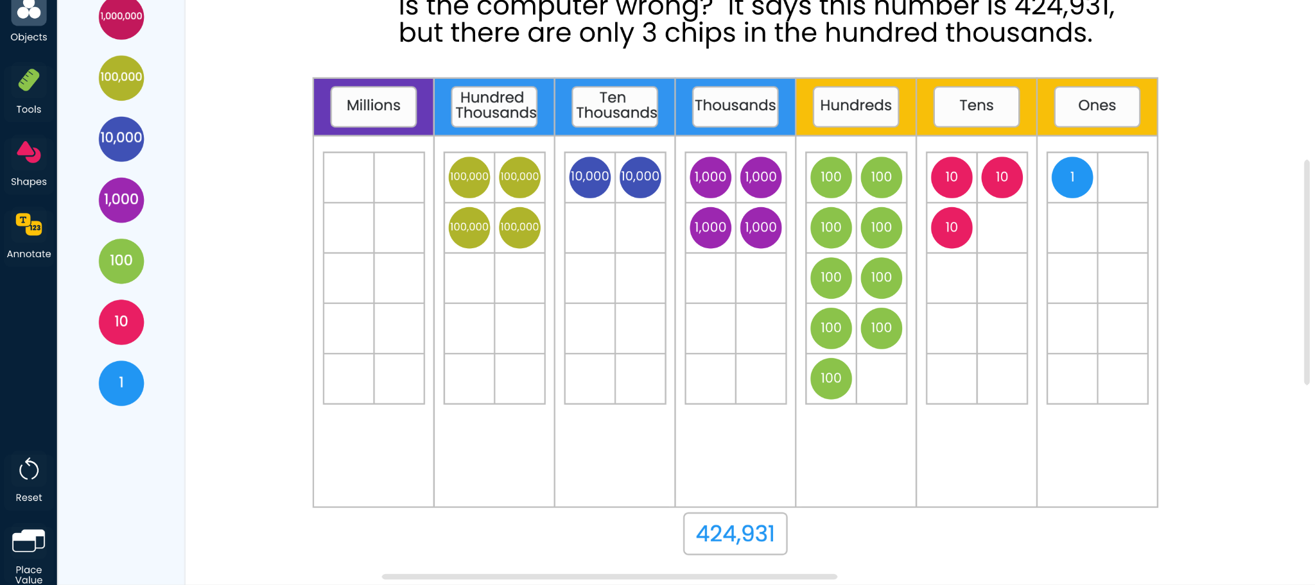
Numbers to 1,000,000
MYGRW3QC
Notes:
Manipulative - Place Value Disks
Workspace - Place Value
Expectation - No, the computer is not wrong. The value of the disk is correct, but the ten-thousand and thousands column has more than 10 of each chip in them. Group 10 or more and move to the left.
Build Notes -
Maximum kept at Millions, but could be adjusted for smaller numbers
Place Value Charts Ten Frames turned on

Slide 5
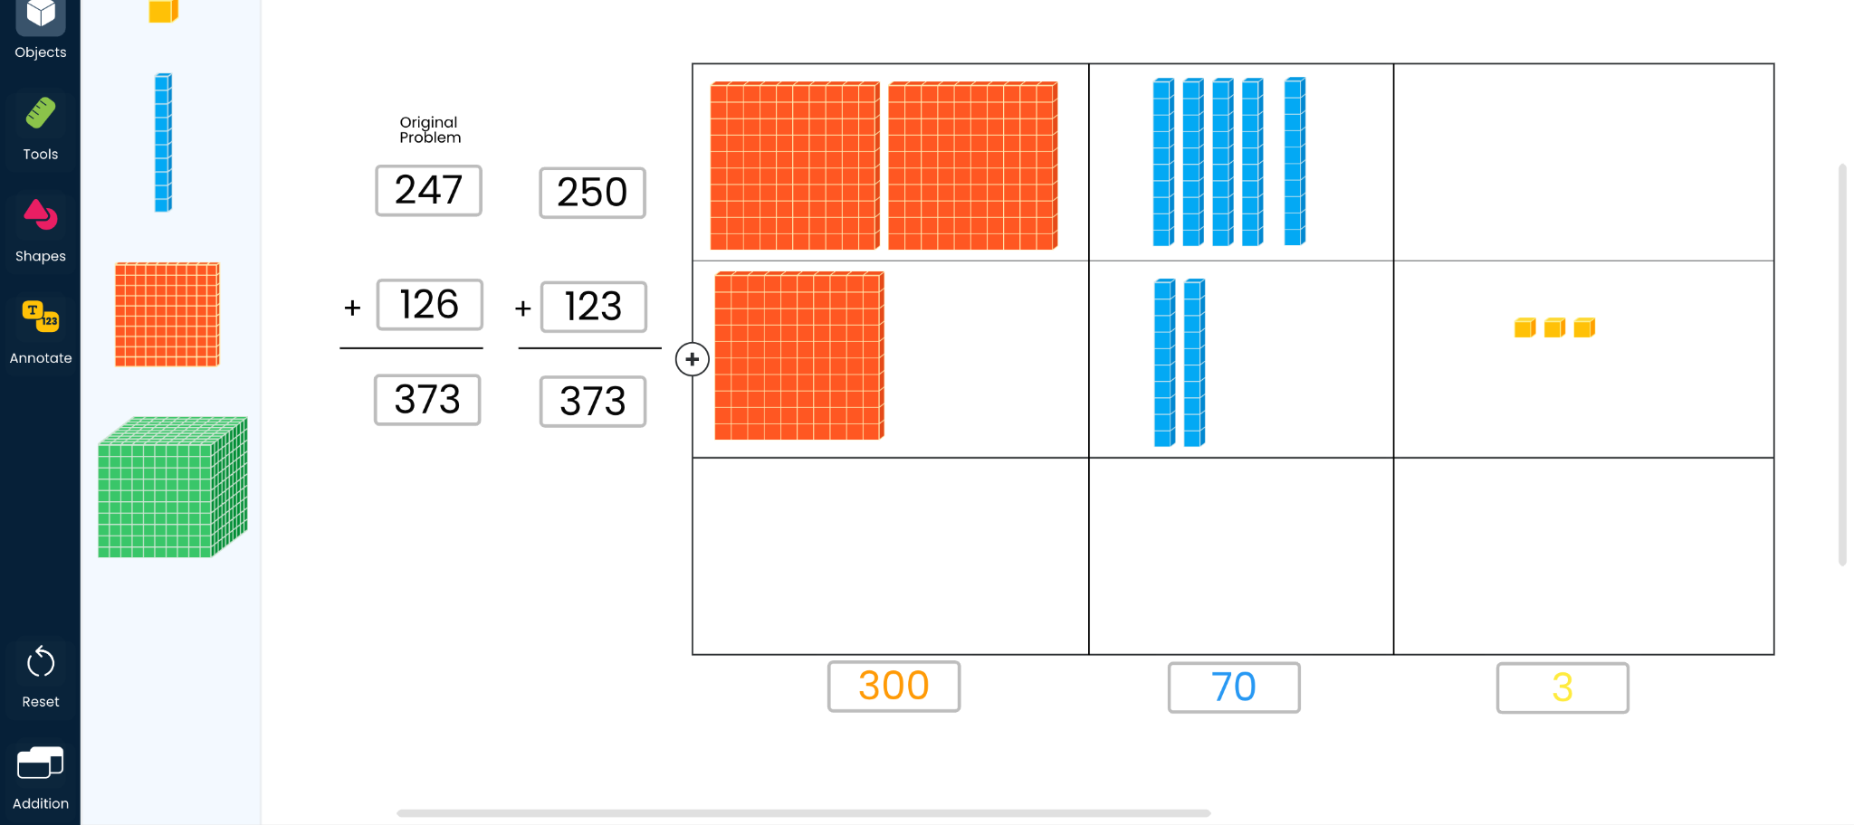
Addition
VD29ZQ6Q
Notes:
Manipulative - Base Ten Blocks
Workspace - Addition
Expectation - Break apart either of the numbers and move some to the other number (Ex: make 126 be 123 and 247 be 250 by moving three cubes up.) Is the addition easier?
Build Notes -
Grey number boxes are in Annotate bin
Changed the color of some to match the color of the blocks

Slide 6
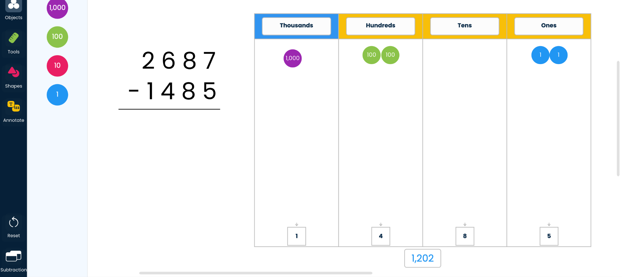
Subtraction
LXT7MU4C
Notes:
Manipulative - Place Value Disks
Workspace - Subtraction
Expectation - Students move what is being subtracted from the chart to the boxes at the bottom. It should match the amount being subtracted, what is left is the answer. It won’t matter if they subtract left to right or right to left.
Build Notes -
Maximum set to 1,000 for this example
If needing to “Borrow” drag a place value chip one column to the right to see it break apart - represent it in the problem to the left.

Slide 7
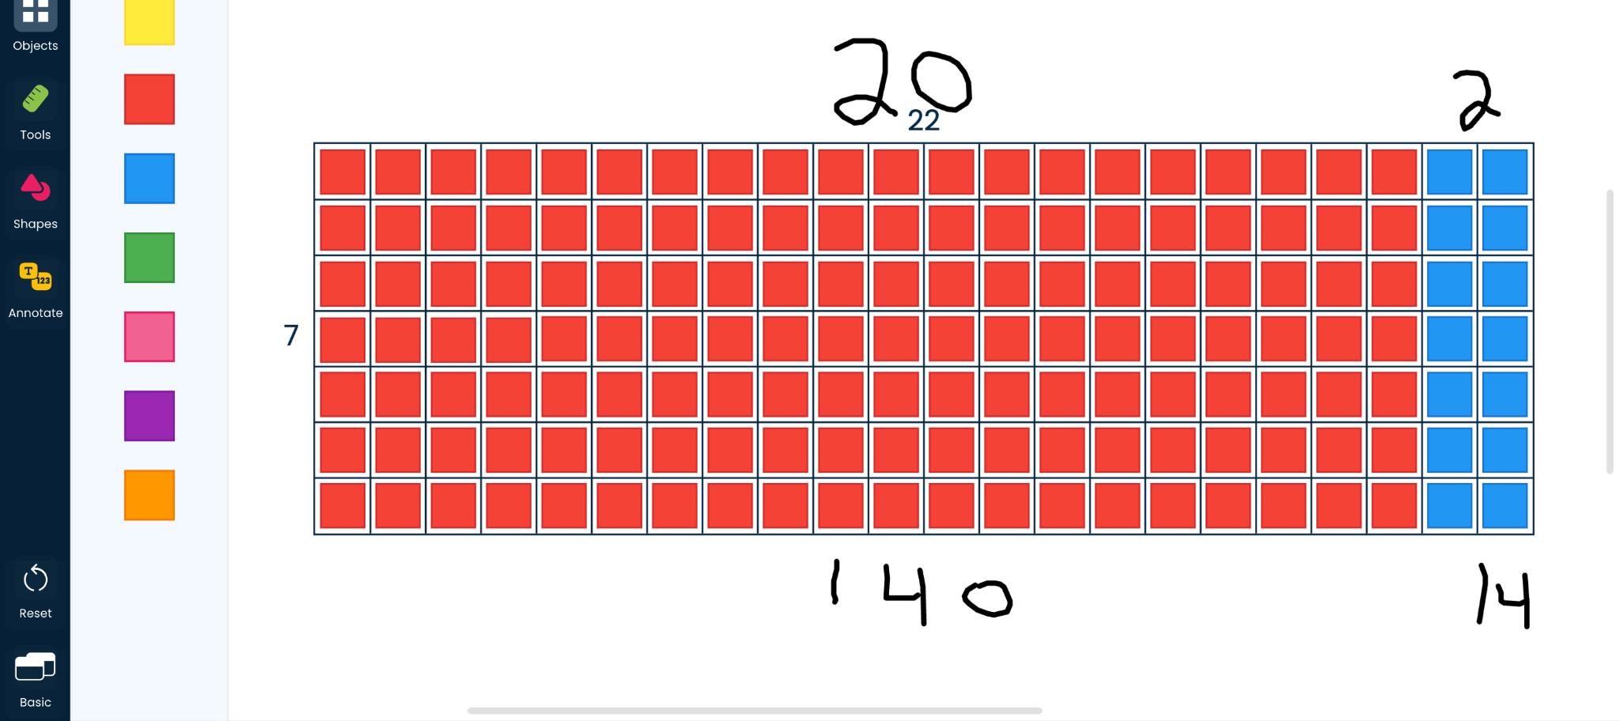
Multiplication
D4Q7E3C7
Notes:
Manipulative - Color Tiles
Workspace - Basic
Expectation - Use Distributive property to break apart 22 into 20 + 2 (or 10 + 10 + 2). Show how breaking apart one of the factors can make multiplication easier.
Build Notes -
Used Array Frame from Tools - adjusted to show 22 X 7 (can turn labels off)
To change colors, select the tiles you want to change, then select the color. (Try not to include the Array Frame when selecting the tiles)
Turn on Workspace Labels to see how many of each color are on the screen.

Slide 8
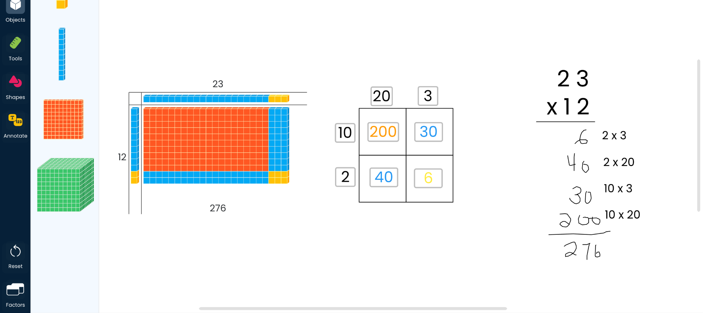
Area Model Multiplication
6X8PUTW5
Notes:
Manipulative - Base Ten Blocks
Workspace - Factors
Expectation - Use the lengths of each block to determine which block can fill the area model. Uncover the first area to see this as Partial Product. Uncover the last area to see a different way to represent the problem.
Build Notes -
Adjusted the factor frame to match the problem
Used squares in the Shapes bid to make the partial product boxes
Added Number input from Annotations and changed the color of each to match the color of the blocks.

Slide 9
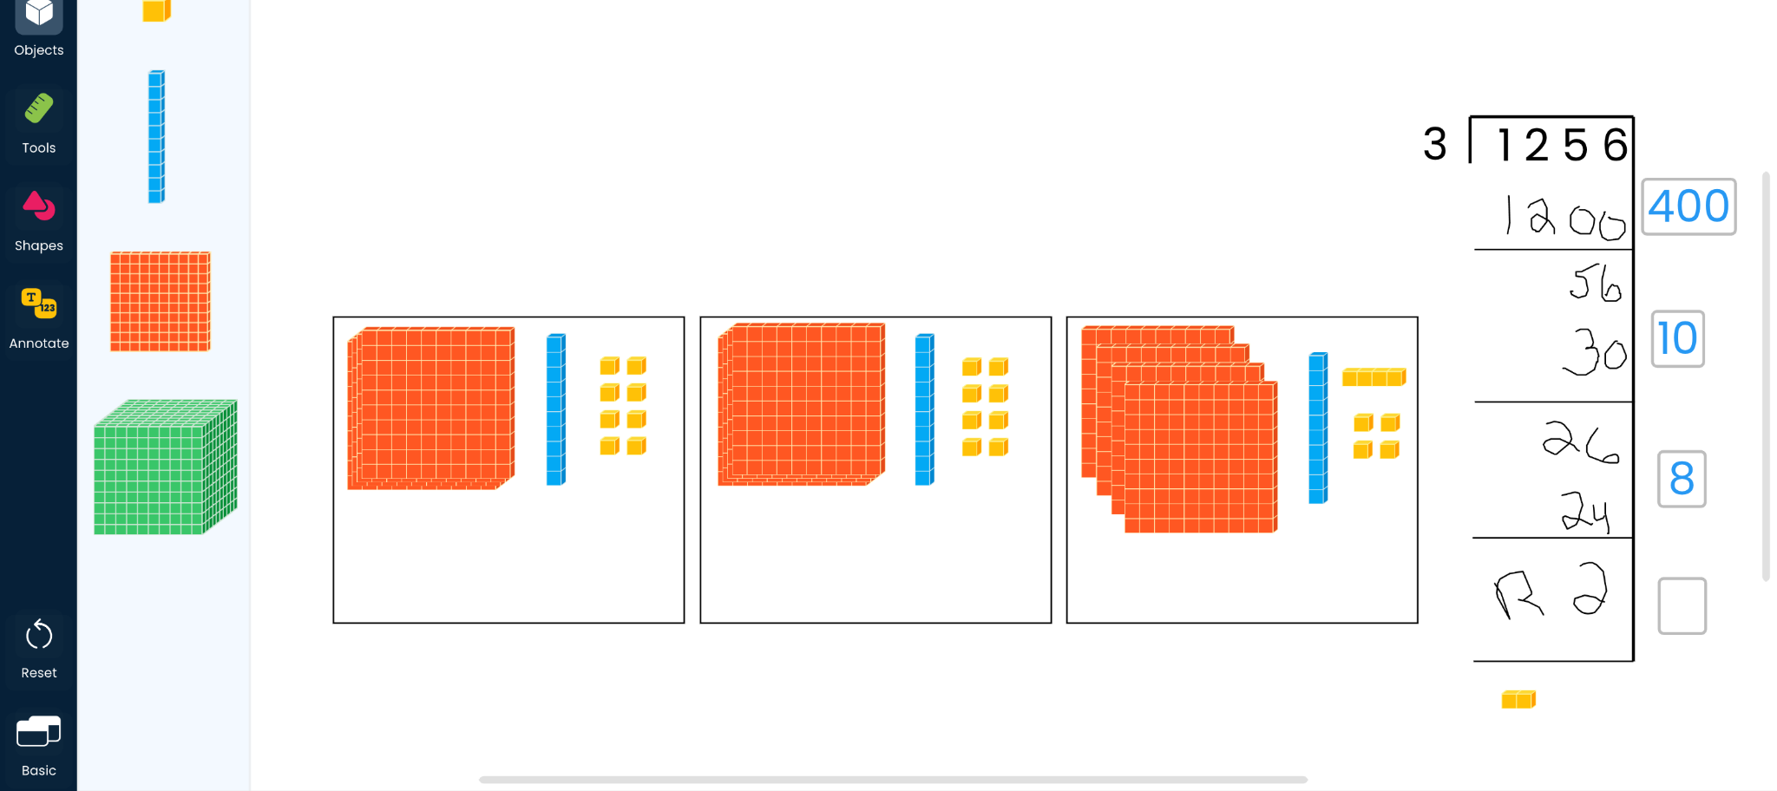
Division
MHYMC19L
Notes:
Manipulative - Base Ten Blocks
Workspace - Basic
Expectation - Students evenly divide the blocks between the three areas. If they need to break a block apart to make smaller blocks, click on it and select Break. What happens with anything left over.
Build Notes -
Used Squares in Shapes to create the areas.
Used Number in Annotate for students to add the groups they take out.
Used the Line Tool in Shapes to build the Partial Quotient model.

Slide 10
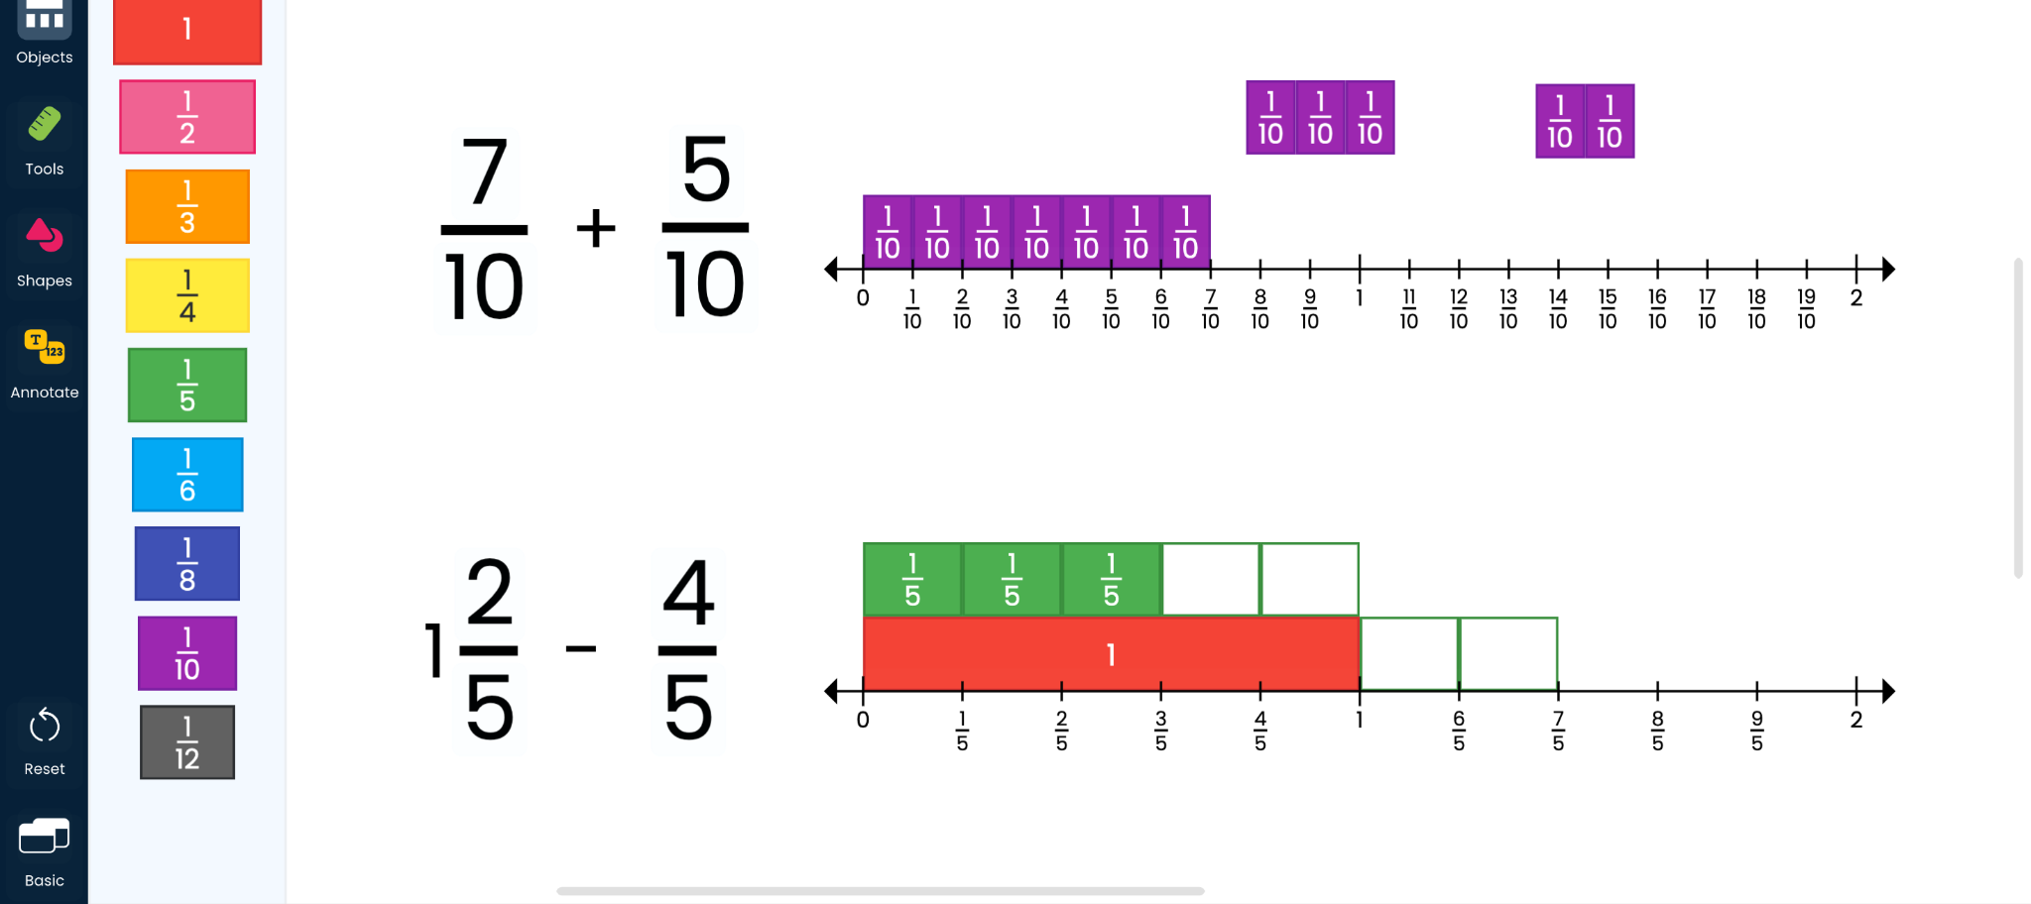
+/- Fractions
QWQ47SBU
Notes:
Manipulative - Fraction Tiles
Workspace - Basic
Expectation - When adding, break of the addends up to make a whole, then add 1 and whatever is left. When subtracting, subtract ⅖ first to get to 1, then again to make a total of ⅘.
Build Notes
Added a number line from Tools, expanded the number line to 2, used the blue slider to label the best denominators.

Slide 11
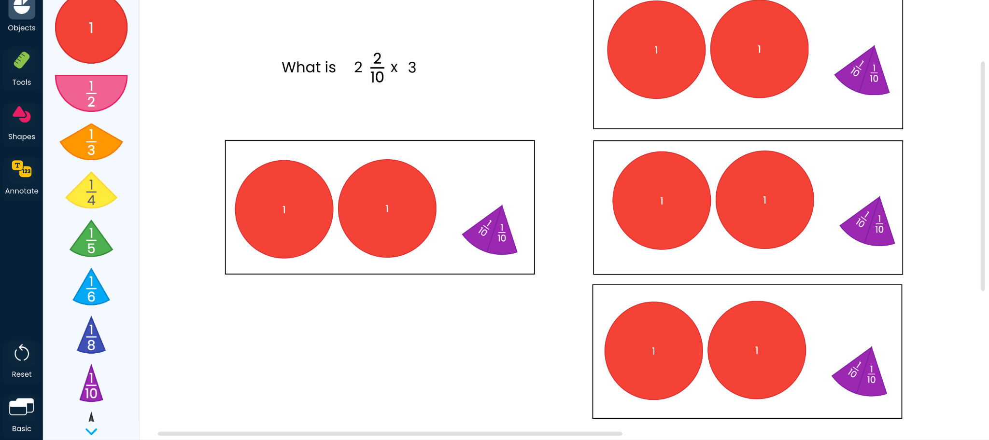
X Fractions
GTEX1AZ3
Notes:
Manipulative - Fraction Circles
Workspace - Basic
Expectation - copy the 2 2/10 three times. For decomposition, break the mixed number into whole number and fraction. Multiply each by 3.
Build Notes -
Made rectangles by using the square in Shapes and then resizing it.

Slide 12
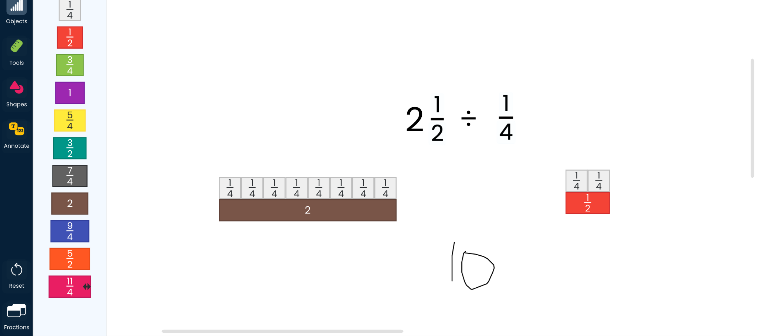
Division of Fractions
F81VPTYA
Notes:
Manipulative - Cuisenaire Rods
Workspace - Fractions
Expectation - Break the mixed number into 2 and ½. How many 1/4th are needed to make each section?
Build Notes -
Turned on Simplified Form
Changed Whole to be the Purple Rod

Slide 13
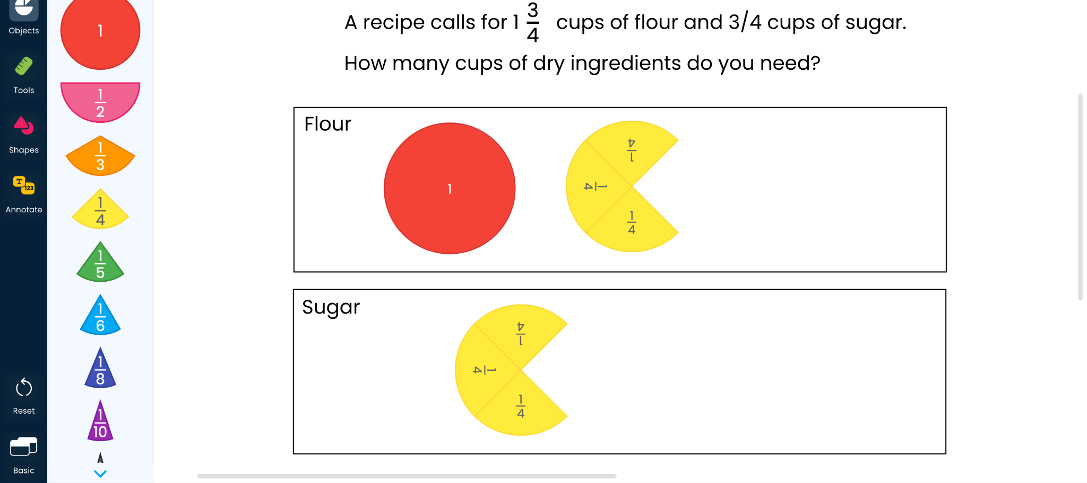
Cooking
CXRYGLUL
Notes:
Manipulative - Fraction Circles
Workspace - Basic
Expectation - Build each number. Move one of the ¼ pieces to complete the other, then solve.
Build Notes -
Just text and shapes to make the rectangles.

Slide 14
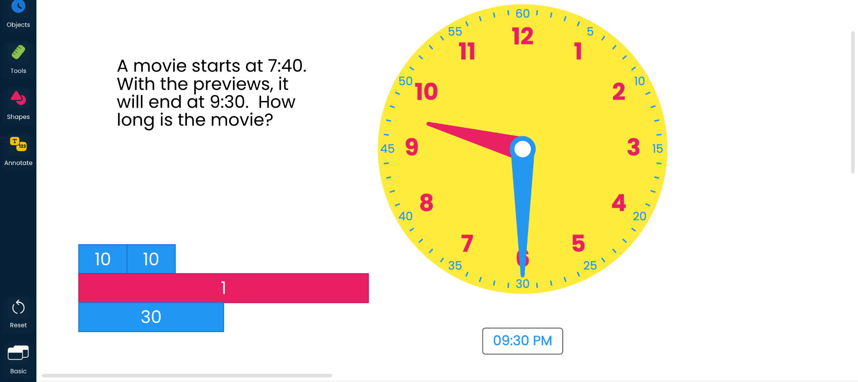
Movie Times
7YG1FQW2
Notes:
Manipulative - Clock
Workspace - Basic
Expectations - Count 20 minutes to get to 8:00. Add 1 hour to get to 9:00, then add 30 minutes to get to 9:30
Build Notes -
Turn on digital clock if needed.
Add time bars to the sides of the clock to help re-adjust the time.
Possibly turn on Tracker to show elapsed time.

Slide 15
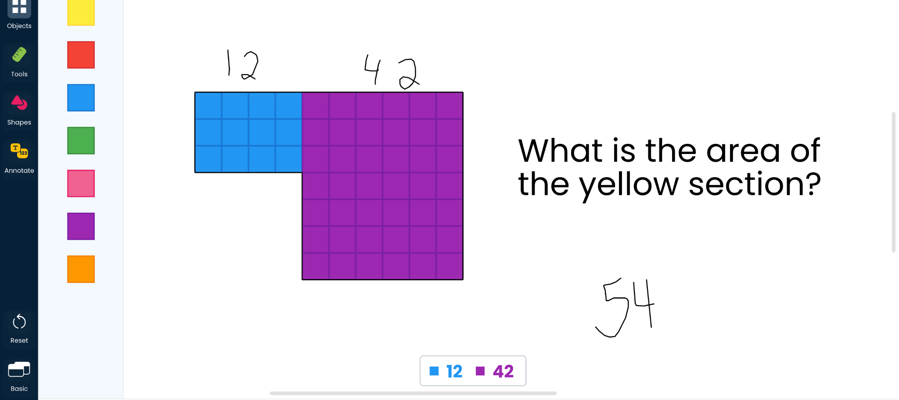
Area of Shapes
W6KWF9RW
Notes:
Manipulative - Color Tiles
Workspace - Basic
Expectation - Change the color of the tiles to break the shape into smaller areas.
Build Notes
Placed the yellow tiles in the shape I wanted. Used the Line tool in Shape to add a border. Did not use the array to make sure there were no gaps.
Turned on Workspace in Labels for the picture.

Slide 16
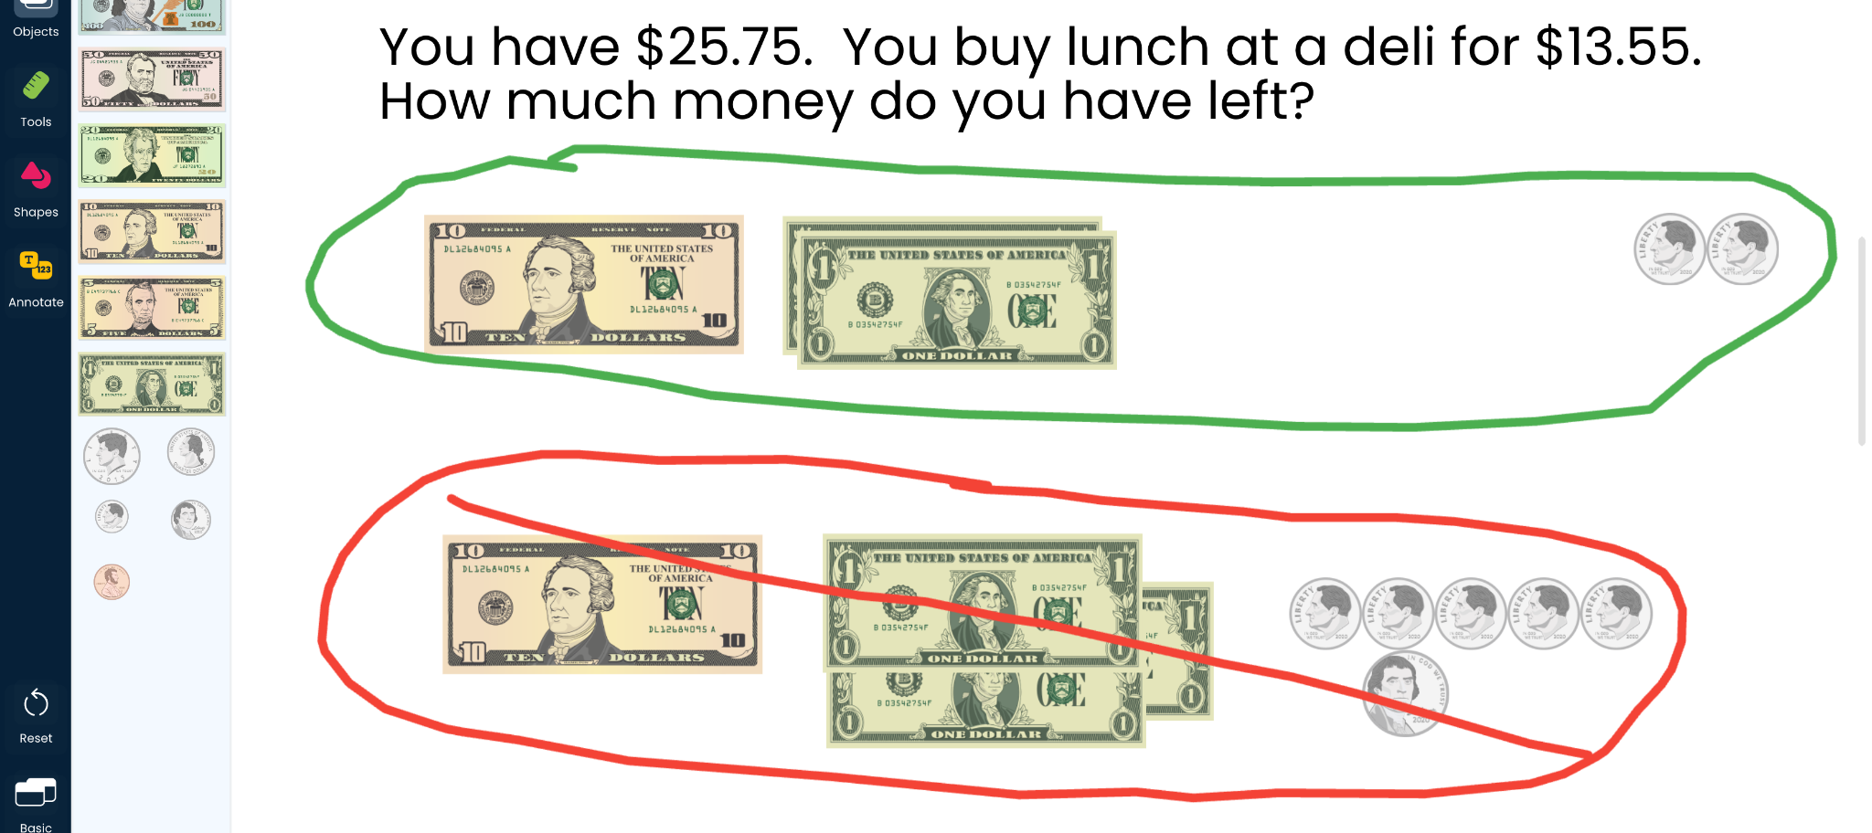
Lunch Money
61FEAPTZ

Slide 17
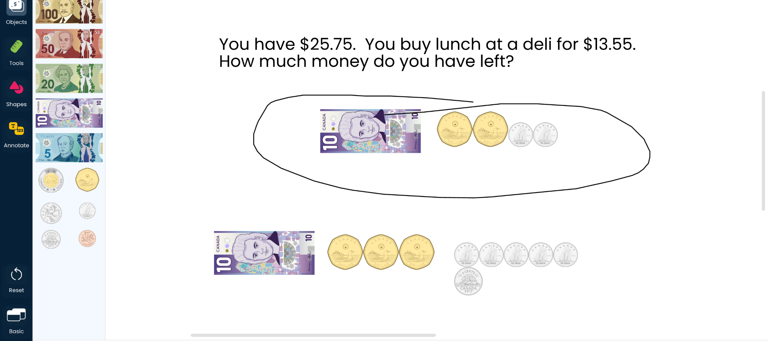
Lunch Money (CAD)
GHNLPJZH
Notes:
Manipulative - Money
Workspace - Basic
Expectation - Break dollars and coins apart. Separate problem into subtraction the bills, then the coins or vice versa.
Build Notes -
Originally made with Canadian Currency, would need to be remade with USD.
Turn on All Bills

Slide 18
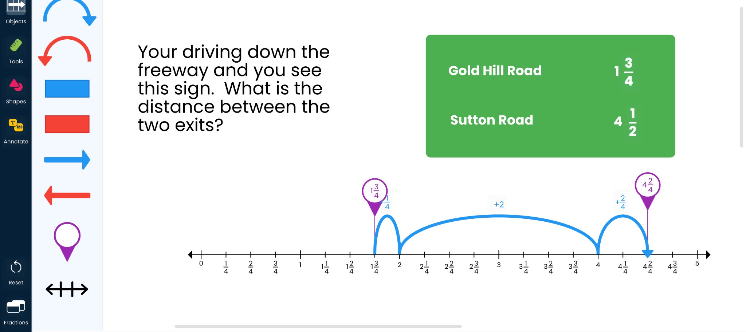
Miles to Go
79JHRWJK
Notes:
Manipulative - Number Line
Workspace - Fractions
Expectation - Use jumps to get to easier numbers to use. Then add up the jumps.
Build Notes -
Customized the Number line to go from 0 - 5
Adjusted the denominators to be fourths.
Added Purple flags to show the start and end locations.
White text to make it look like a road sign.

Slide 19
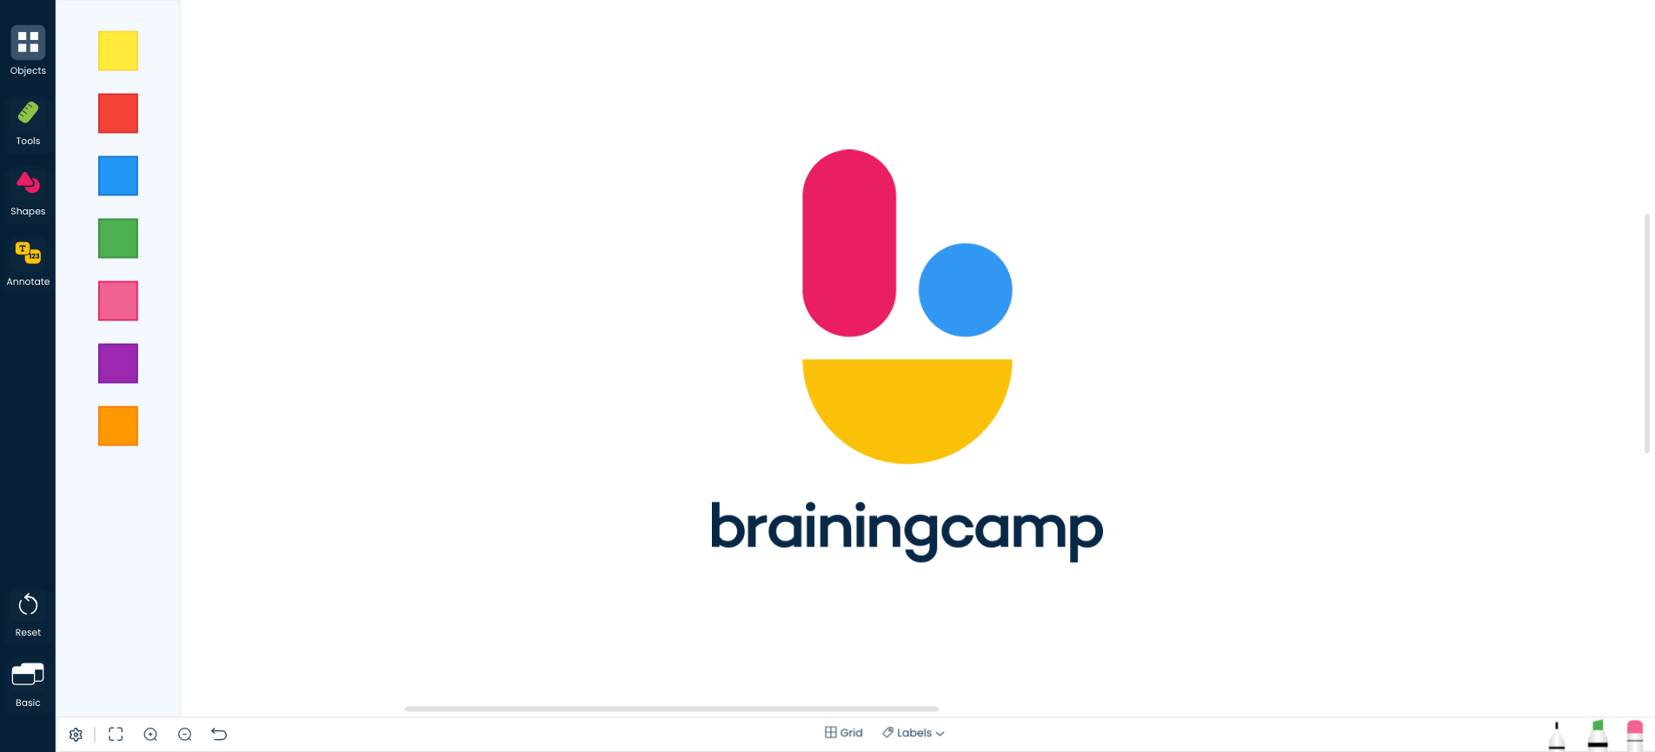
Title
Share Code

Slide 20
Title
Share Code

Slide 21
Title
Share Code

Slide 22
Title
Share Code

