Slide 1
Write a three-digit number.
Match the CONDITION to earn a point.
Your number
has 5 in it
is between 200 and 500
rounds to 700
has a sum of digits that are even
is the smallest three-digit number in the class

Slide 2
Create a number on your ten frames.
Match the CONDITION to earn a point.
Your number
is the smallest number in
the class
is more than 10
is one more than 7
is more than 12
is two more than 4
is between 11 and 16 on a number path

Slide 3
Choose a number from the hundred chart.
Match the CONDITION to earn a point.
Your number
is more than 20
has a 6 in it
has 8 ones
is close to 100
is between 55
and 65
1 | 2 | 3 | 4 | 5 | 6 | 7 | 8 | 9 | 10
11 | 12 | 13 | 14 | 15 | 16 | 17 | 18 | 19 | 20
21 | 22 | 23 | 24 | 25 | 26 | 27 | 28 | 29 | 30
31 | 32 | 33 | 34 | 35 | 36 | 37 | 38 | 39 | 40
41 | 42 | 43 | 44 | 45 | 46 | 47 | 48 | 49 | 50
51 | 52 | 53 | 54 | 55 | 56 | 57 | 58 | 59 | 60
61 | 62 | 63 | 64 | 65 | 66 | 67 | 68 | 69 | 70
71 | 72 | 73 | 74 | 75 | 76 | 77 | 78 | 79 | 80
81 | 82 | 83 | 84 | 85 | 86 | 87 | 88 | 89 | 90
91 | 92 | 93 | 94 | 95 | 96 | 97 | 98 | 99 | 100

Slide 4
Write a basic addition fact.
Match the CONDITION to earn a point.
Your addition fact has a
sum greater than ten
doubles fact
plus one fact
make ten fact
even sum
make ten and some more

Slide 5
Write a three-digit number.
Match the CONDITION to earn a point.
Your number
has a 5 in it
is between 200 and 500
rounds to 700
has an even sum of the digits
is the smallest three-digit number in the class

Slide 6
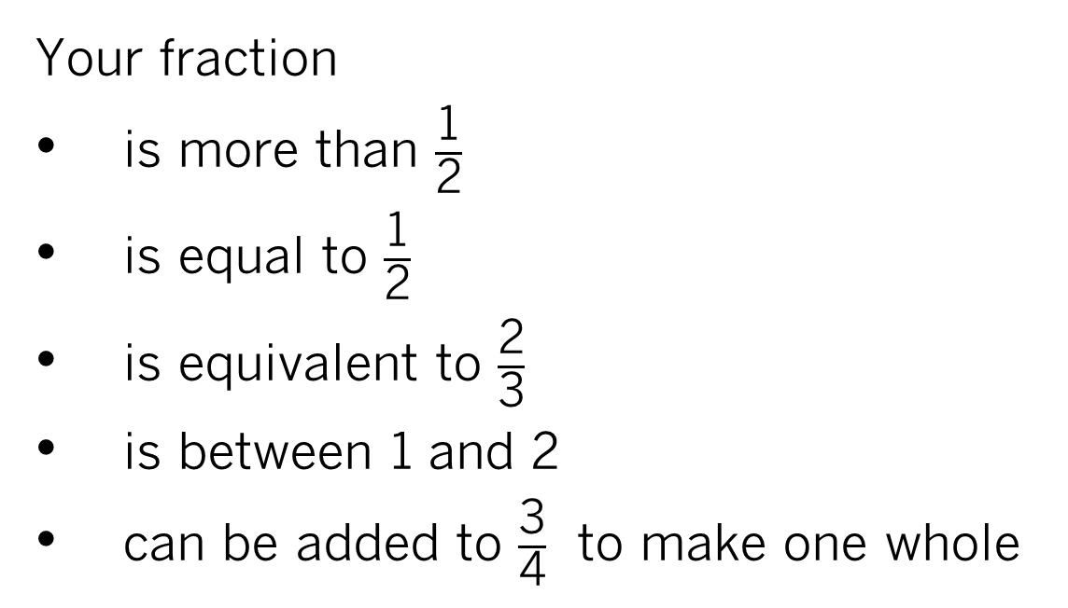
Write a fraction.
Match the CONDITION to earn a point.
Your fraction
is more than $\frac{\text{1}}{\text{2}}$
is equal to $\frac{\text{1}}{\text{2}}$
is equivalent to $\frac{\text{2}}{\text{3}}$
is between 1 and 2
can be added to $\frac{\text{3}}{\text{4}}$ to make one whole

Slide 7
Write a decimal number less than 10.
Match the CONDITION to earn a point.
Your decimal
is between 5 and 6
has a two in it
has 8 hundredths
has no hundredths
has no tenths

Slide 8
Write a number less than 100.
Match the CONDITION to earn a point.
Then pass your number to someone else.
Your number
rounds to 80
has a 4 in it
is even
is the largest number in the class
is close to 0

Slide 9
Write a number less than 100.
Stand up if you meet the CONDITION.
Sit down if you don’t meet the CONDITION.
Your number
has eight ones
is larger than 50
is between 70 and 90
is 20 or more less than your partner

