Slide 1
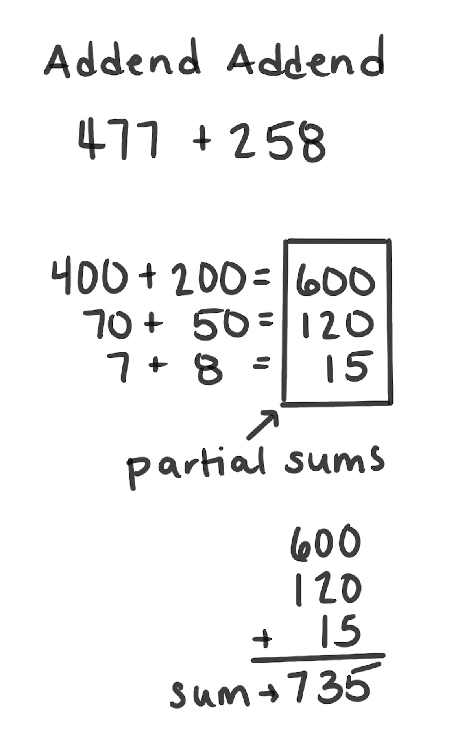
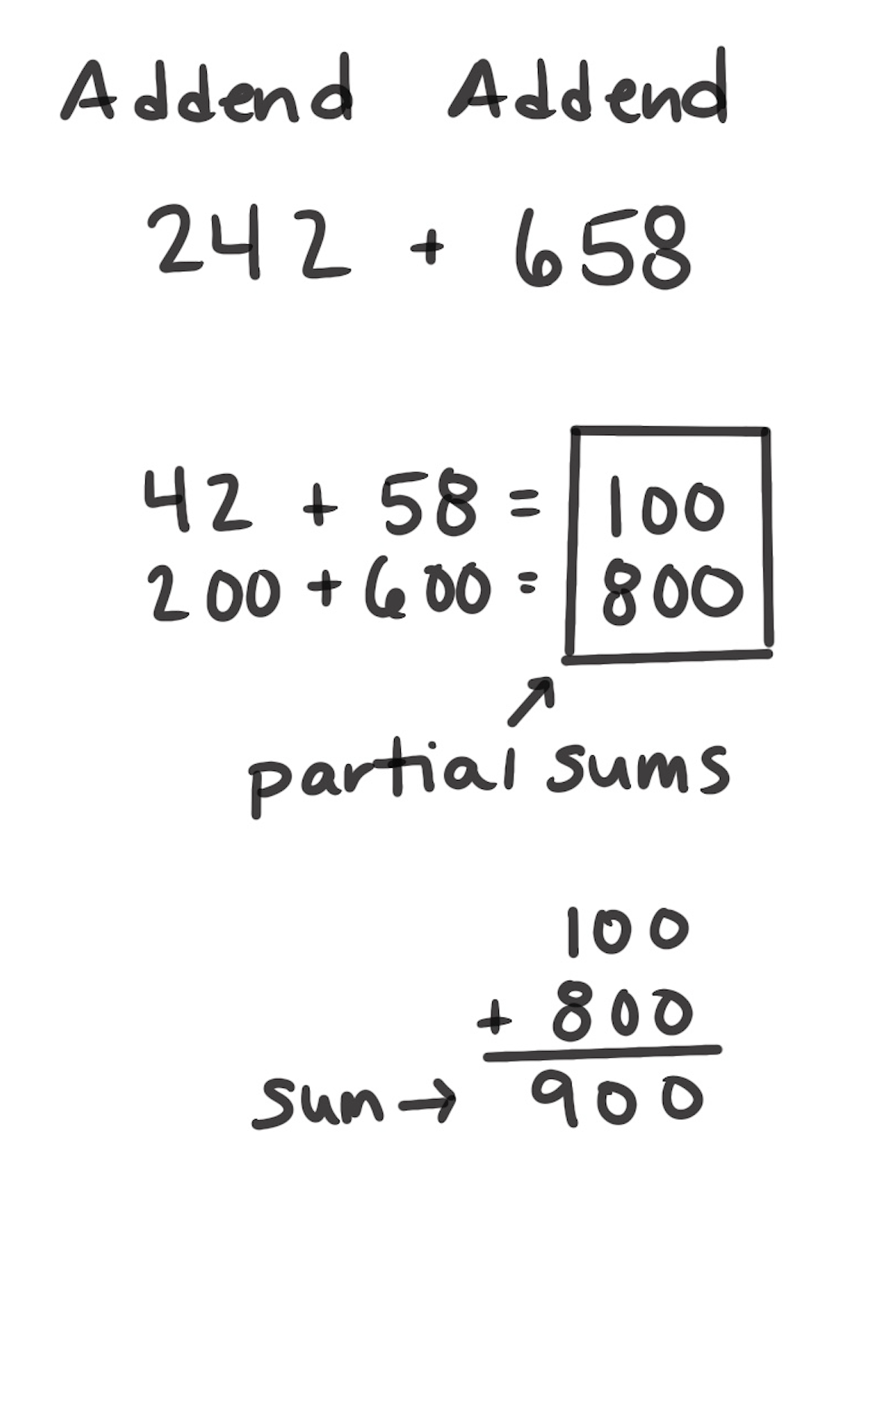
Partial Sums Strategy
How It Works: We can break apart addends in different ways. We add the parts to find partial sums. Then, we can add the partial sums together to find the answer.
Choose how to break apart the addends.
Add the parts to find each partial sum.
Add the partial sums.
The left example shows that 477 + 258 can be broken apart by place value. Add the hundreds together, add the tens together, then add the ones together. Then, each of those partial sums is added to find the answer to the original problem.
The right example isn’t broken apart by place value because the person noticed that 42 and 58 make a hundred and broke apart the addends differently.
When It’s Useful: This strategy is useful unless another strategy can be applied more efficiently.

