Slide 1
A Number Bio for 28
Ten more | Break it apart | A number that is more and a number that is less
Ten less | Show it with sticks and dots | On a number line

Slide 2
A Number Bio for 9
A number before it | A number after it | What it looks like on a domino
On a 10 frame | Another way on a 10 frame | Things I might have

Slide 3
A Number Bio for 77
Is close to 0, 50, or 100 | Break it apart | Break apart a different way
The TEN that it is closest to | 5 more and 5 less | On a number line

Slide 4
A Number Bio for 265
Is close to 0, 500, or 1,000 | Break it apart | Added to 125
The closest hundred | 10, 100, and 200 more | How much more to 1,000?

Slide 5
A Number Bio for 4,028
Rounded to the nearest ten, hundred, and thousand | Is about halfway between | Break it apart
On a number line | On a number line with different endpoints | Is the sum of these two numbers

Slide 6
A Number Bio for 7 + 8
Way to think about it | Two related facts | A way to rewrite It
What it looks like? | Related subtraction facts | Another idea I have

Slide 7
A Number Bio for 16 × 7
It’s more than | It’s less than | It’s about
One way to break it apart | Another way to break it apart | Related expression

Slide 8
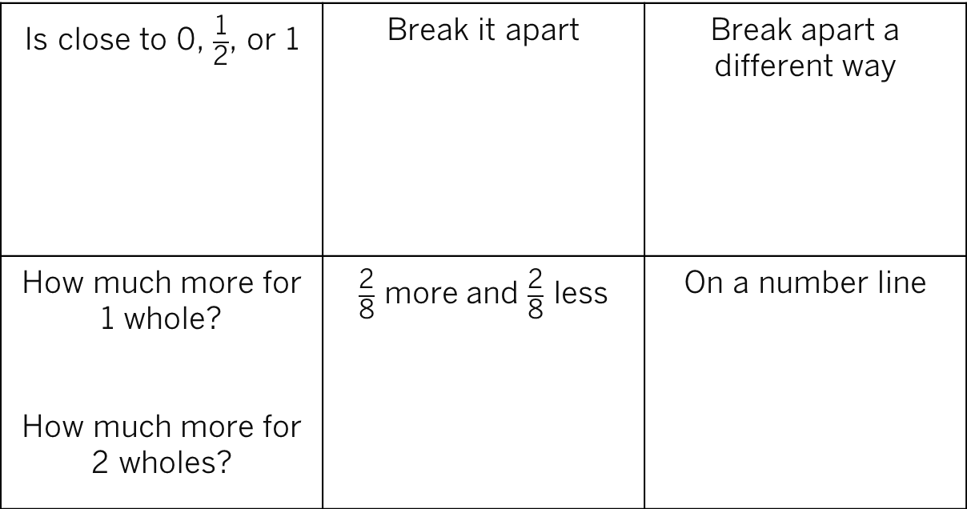
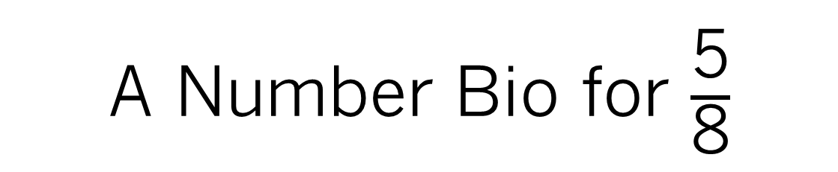
A Number Bio for $\frac{\text{5}}{\text{8}}$
Is close to 0, $\frac{\text{1}}{\text{2}}$, or 1 | Break it apart | Break apart a different way
How much more for 1 whole? How much more for 2 wholes? | $\frac{\text{2}}{\text{8}}$ more and $\frac{\text{2}}{\text{8}}$ less | On a number line

Slide 9
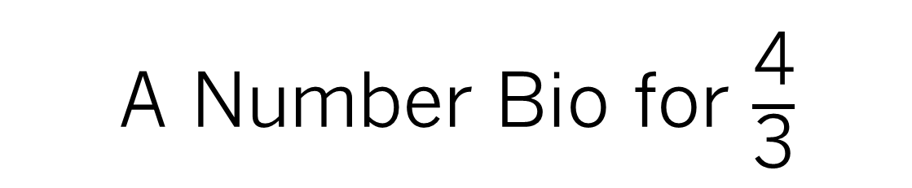
A Number Bio for $\frac{\text{4}}{\text{3}}$
On a number line | A picture of it | Two fractions it is less than
Break it apart | A different picture of it | Create your own idea

